Slide 1
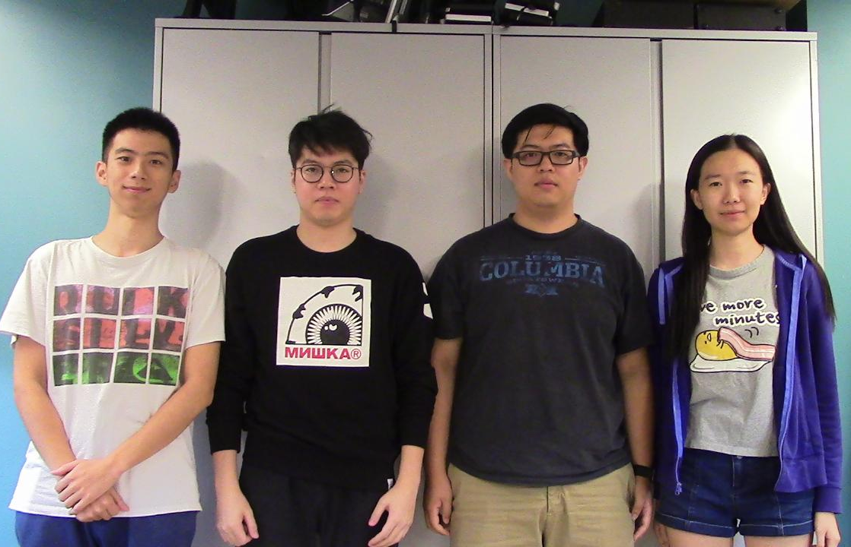
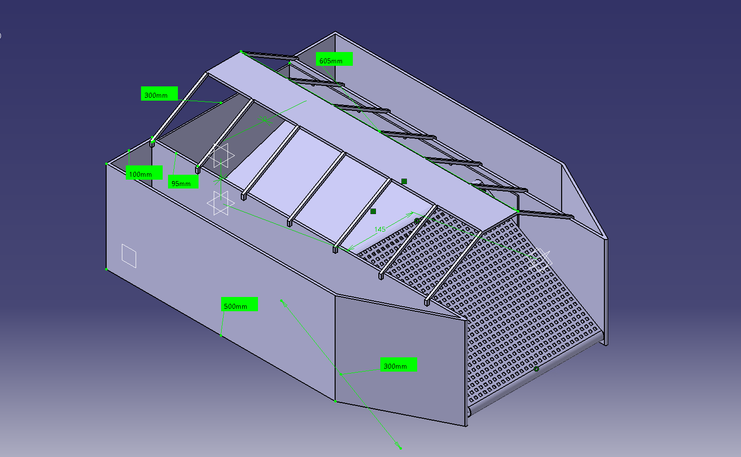
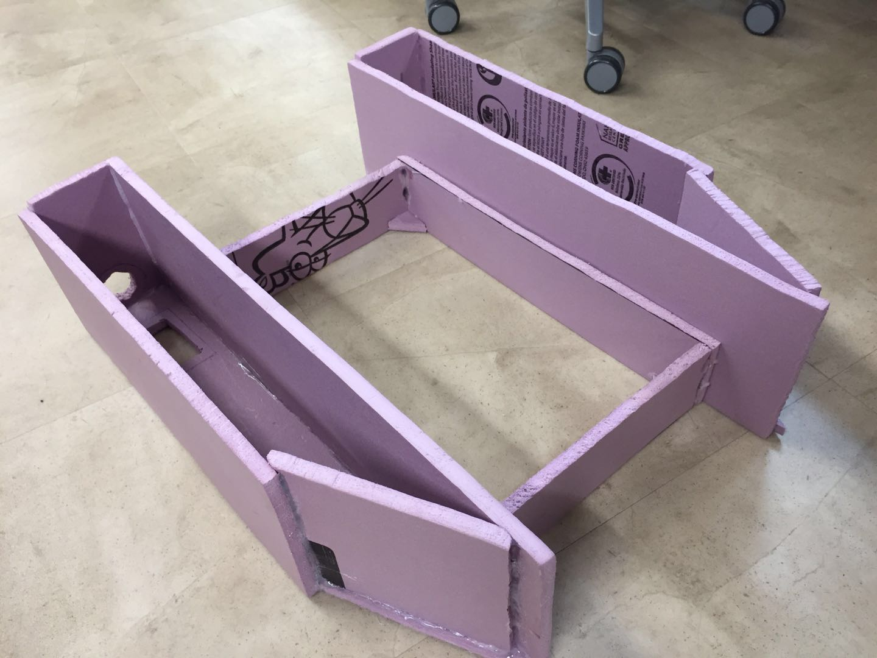
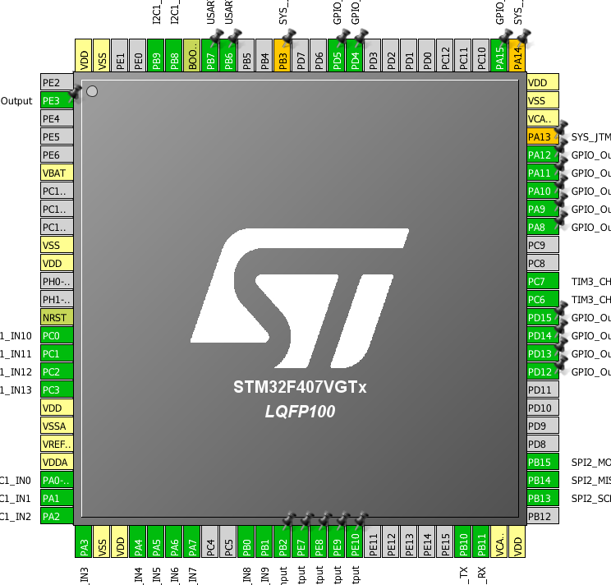
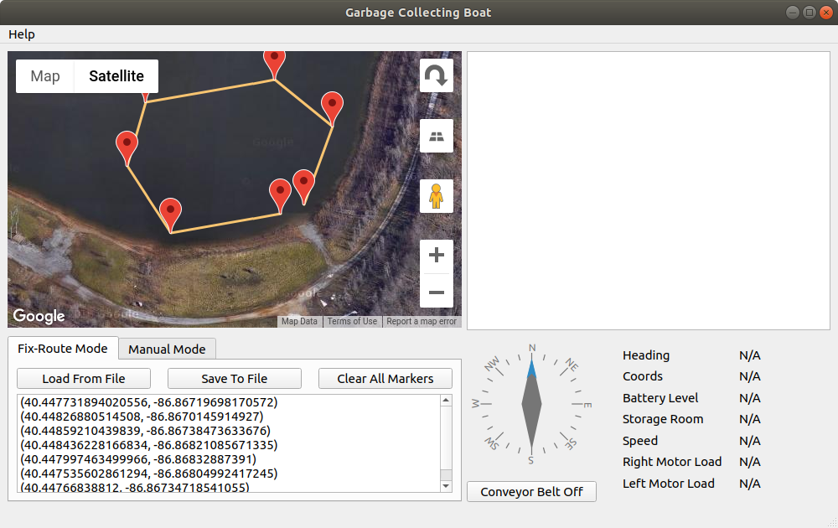
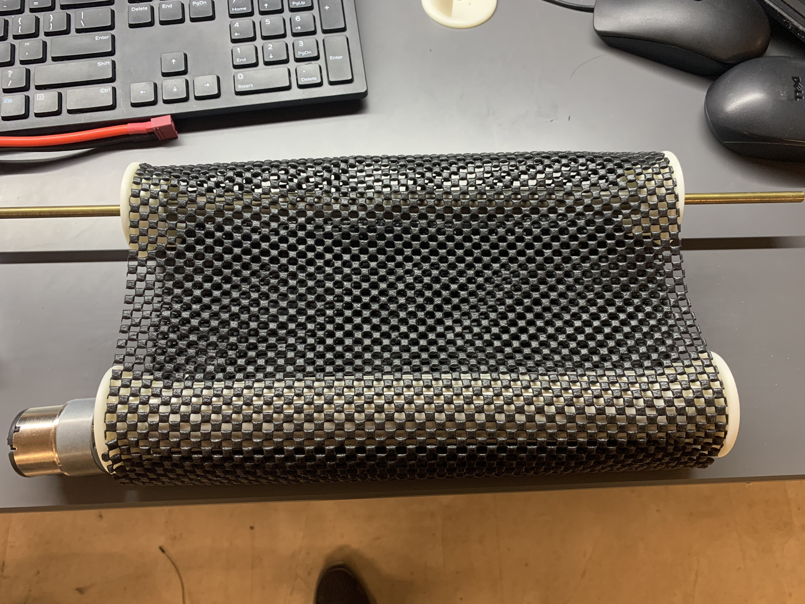
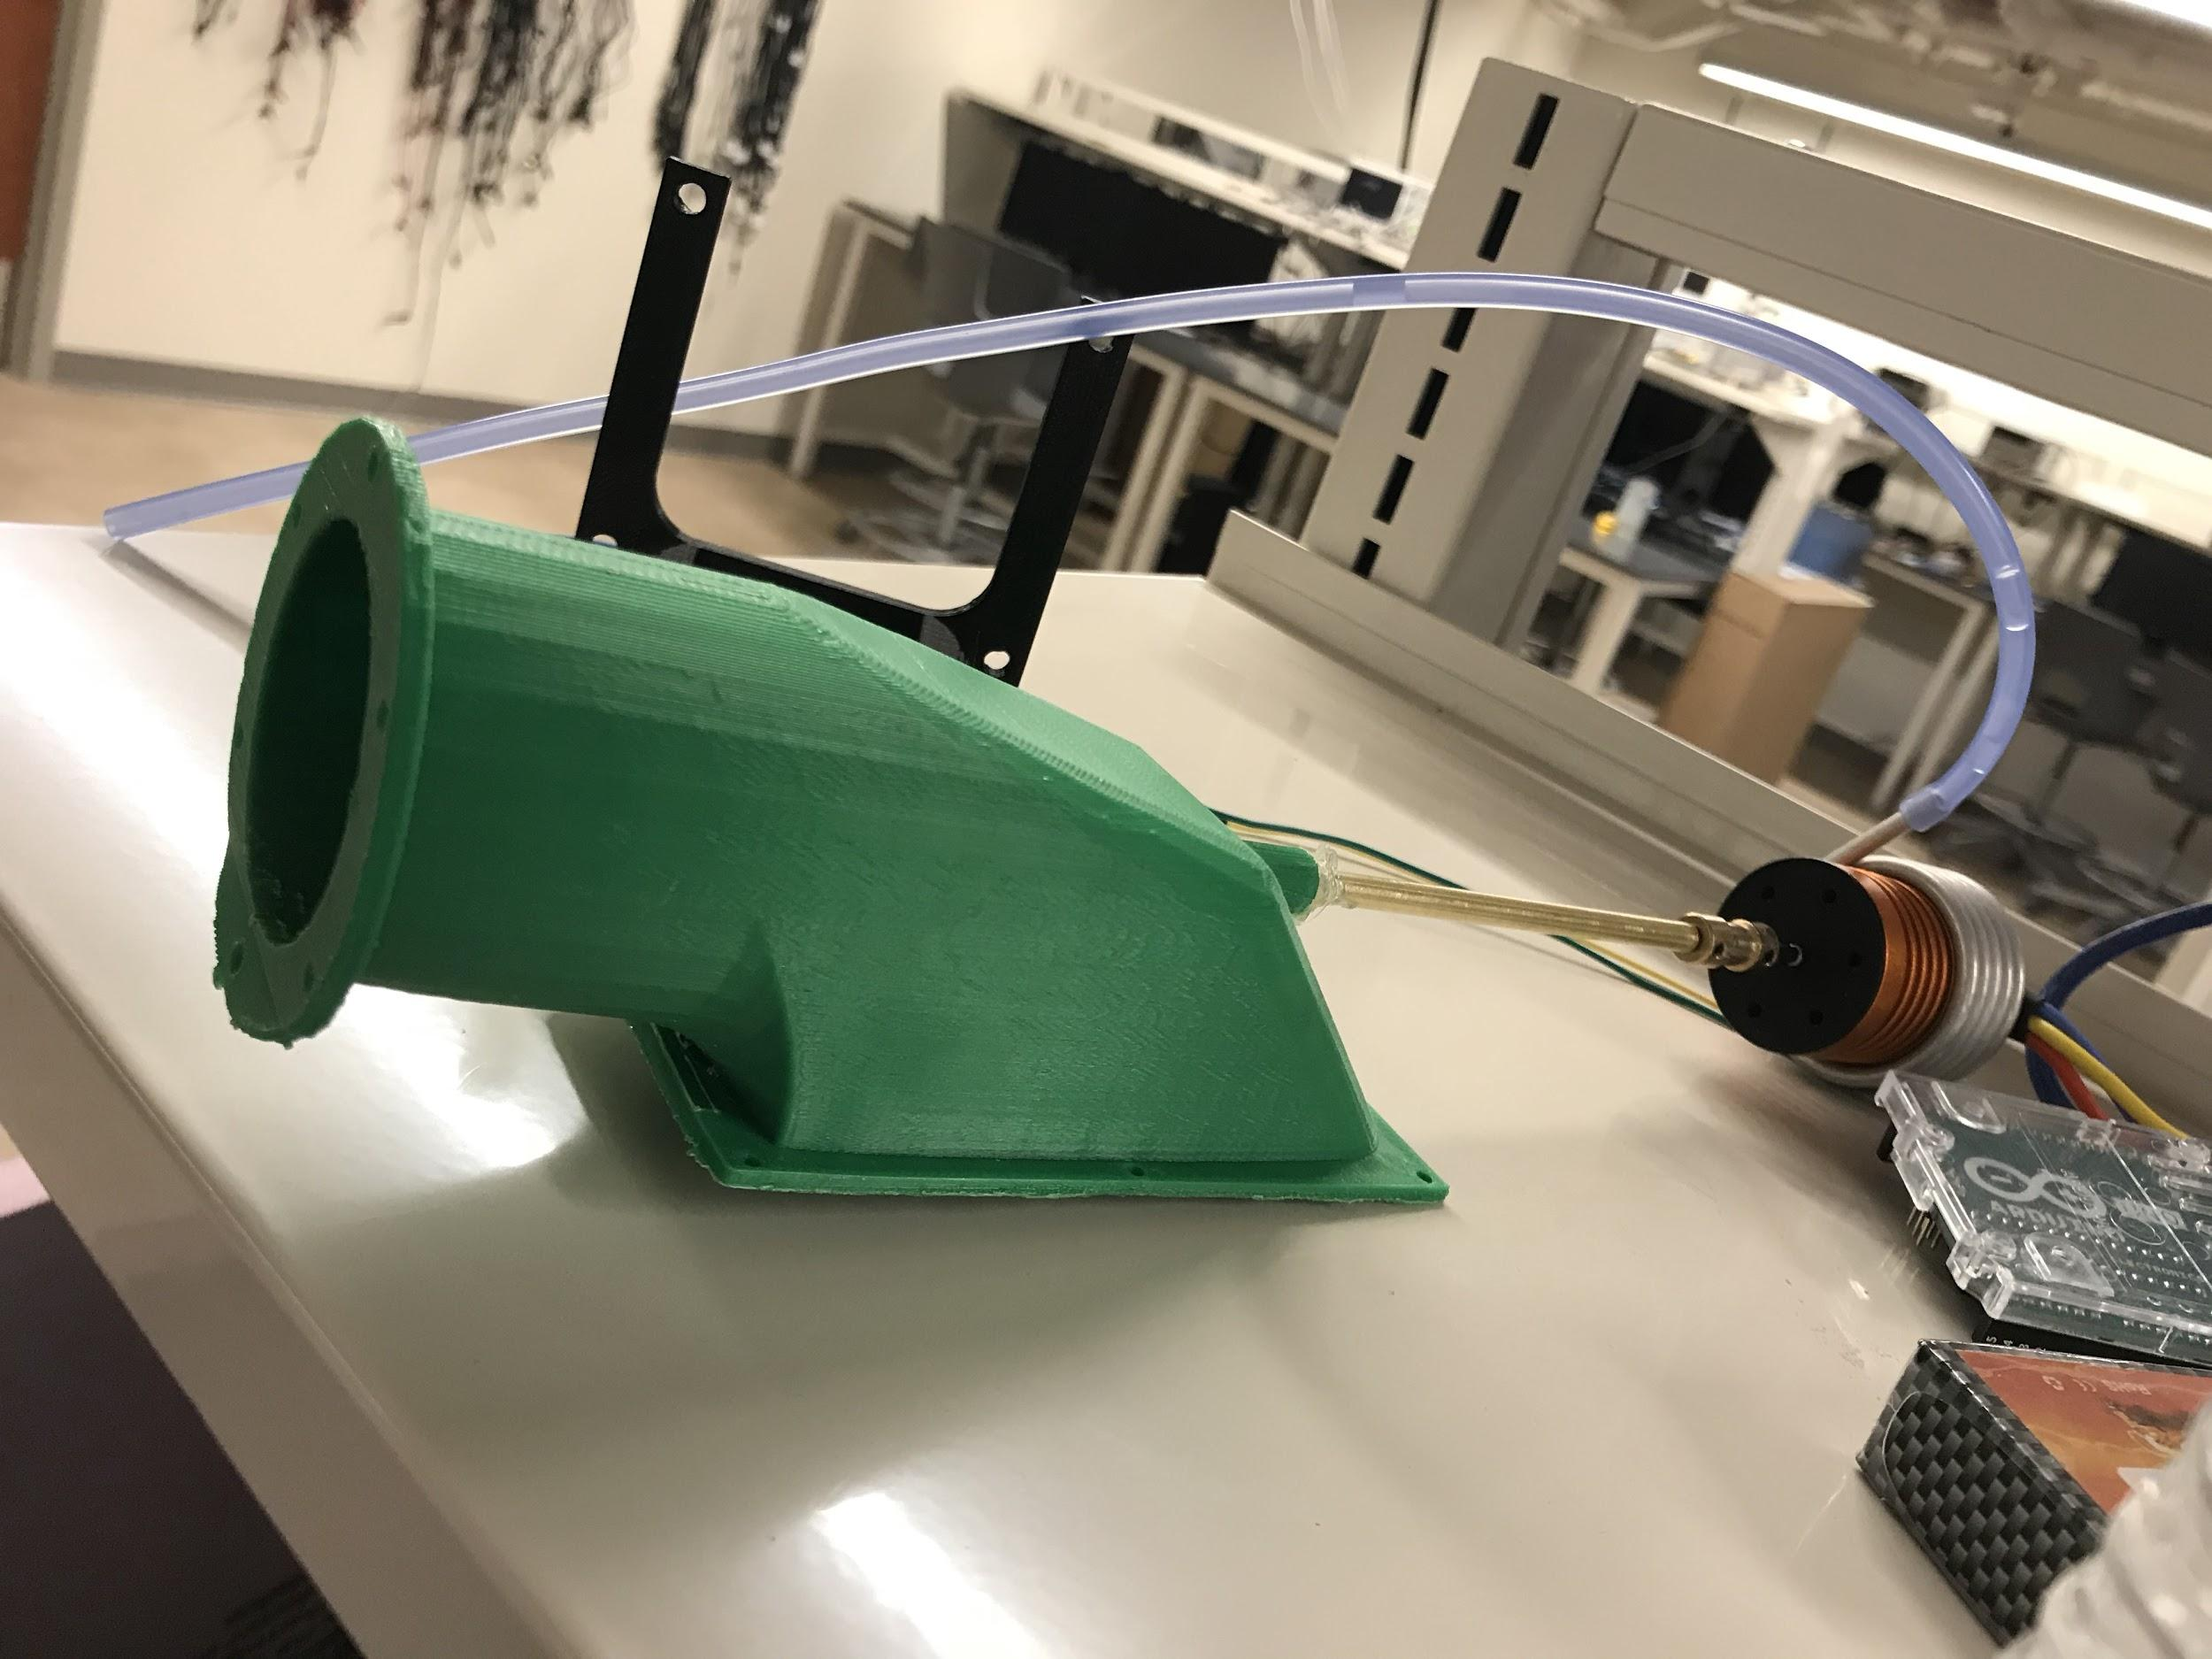
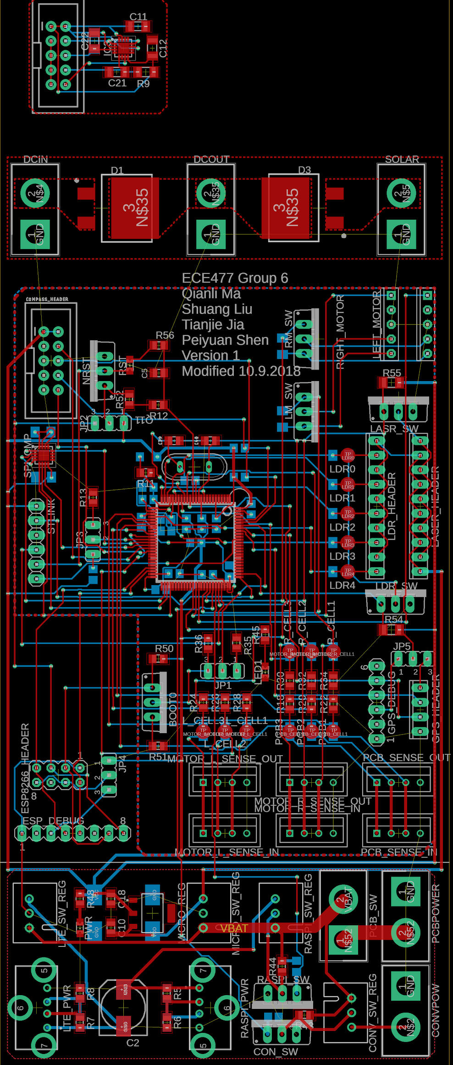
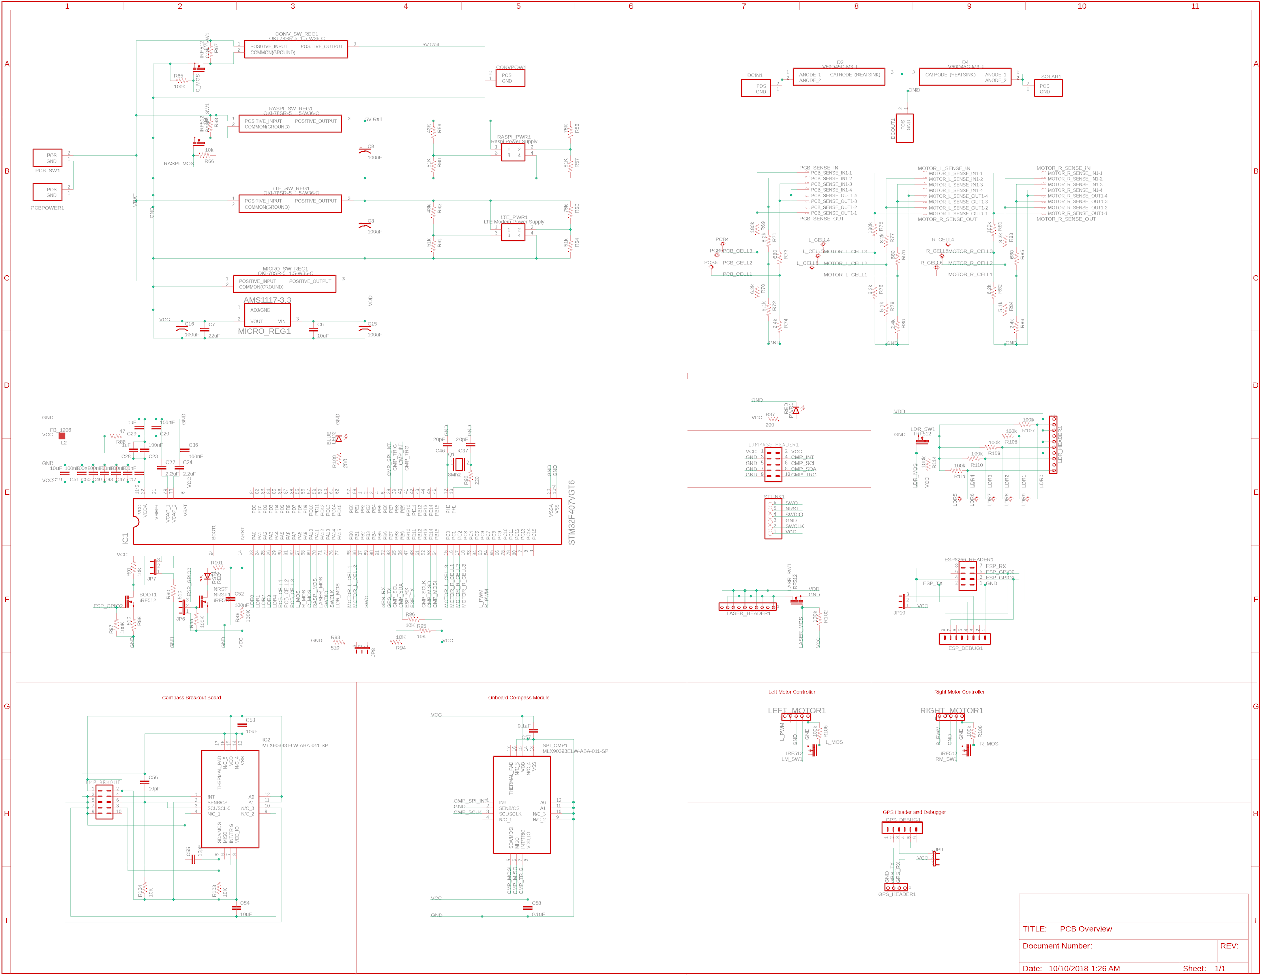

ECE477 MIDTERM DESIGN REVIEW: TEAM 6
Garbage Collecting Boat
Team Members: Tianjie Jia, Shuang Liu, Qianli Ma, Peiyuan Shen

Slide 2
OUTLINE
Project Overview
PSSC
System Diagram
Block Diagram
Packaging Design
Major Components
Electrical Schematic
PCB Layout
Prototyping Progress
Software Development Status
Project Timeline
Questions
Appendix

Slide 3
PROJECT OVERVIEW
Garbage Collecting Boat
A remote-control boat collecting floating garbage
Wi-Fi communication
A Graphical User Interface
Two operation mode
Manual Mode
Fix-route Mode
The user interface on a computer displays
GPS coordinates
Compass degree
Storage room fullness
Google Map
Video Stream
Battery voltage
Notes:
A quick overview to our project. Two parts, the boat, and the user interface on a computer, and these two parts communicate through WiFi. The user can either control the boat manually by pressing arrow key or set a route for the boat.

Slide 4
PSSCS
PSSC #1: An ability to navigate the boat and steer the direction of the boat.
PSSC #2: An ability to receive direction commands set by the user interface via Wi-Fi.
PSSC #3: An ability to enter GPS coordinate points in the user interface and transmit commands to the boat.
PSSC #4: An ability to pause the conveyor belt when the storage room is full.
PSSC #5: An ability to monitor the battery life and storage room and send corresponding retreat signal to the user interface.

Slide 5
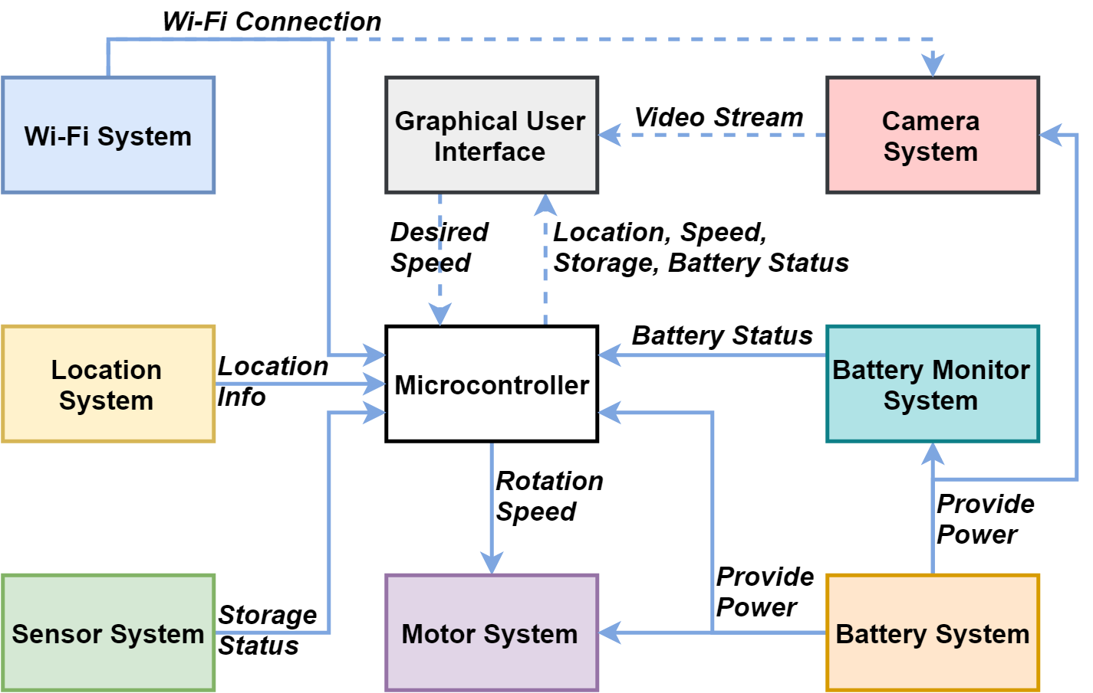
SYSTEM DIAGRAM
Key Sub-Systems Interfaces and Information Transfers
Notes:
This is the overall system diagram everything except the user interface system is on the boat, and most of systems talks to microcontroller and microcontroller report the corresponding signal to the user interface, meanwhile, it also hears the command from the user interface constantly. The camera system run by raspberry pi and raspberry camera is an independent system from the central microcontroller.

Slide 6
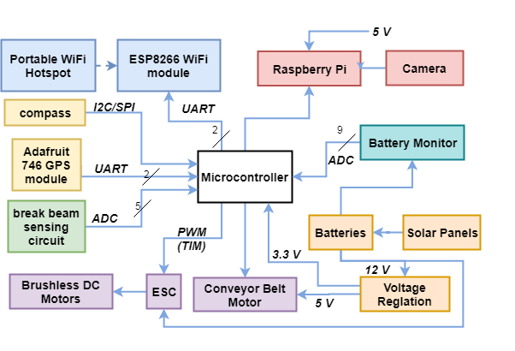
BLOCK DIAGRAM
Detailed System Block Diagram
Notes:
In the WiFi system, there is a portable WiFi Hotspot which provide internet access to the micro and the raspberry pi, the esp8266 is the bridge between the hotspot and the micro using UART protocol. The location system has a compass using either I2c or SPI, and GPS module using UART. The storage sensing system uses break beams, the mechanism is quite simple and I will explain it later in the package design section. The motor system has two parts, one to drive the whole boat is two brushless DC motors controlled by ESC electronic speed control, the speed is controlled by PWM signal from micro. Another part to operate the conveyor belt at a constant speed, is two brushed DC motors. In the battery system, there is voltage regulation cutting 12V down to 5V, and 3.3V as power supply for different systems. The voltage of each cell of battery will be monitored and read by the microcontroller. All the adc input to microcontroller is 12 bit resolution.

Slide 7
PACKAGING DESIGN
Overall CAD Model Illustration
Notes:
two watertight cabins on sides which provide buoyancy and contain most of the hardwares. in the middle is the garbage storage room. The conveyor belt lift the floating garbage and sent it to the storage room. the structure on the top provides skeleton for solar panel, camera and GPS module.

Slide 8
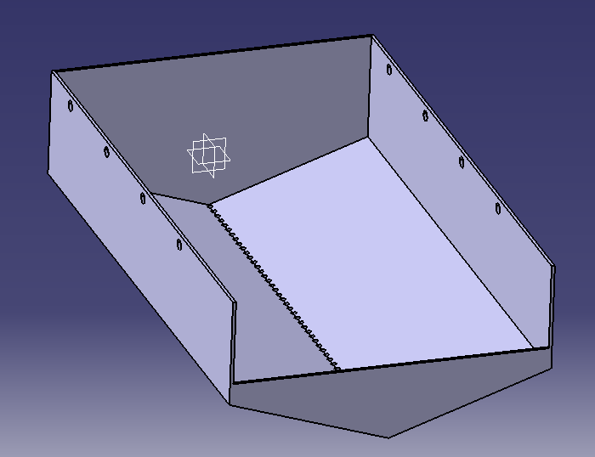
PACKAGING DESIGN
Detailed CAD Model Illustration

Slide 9
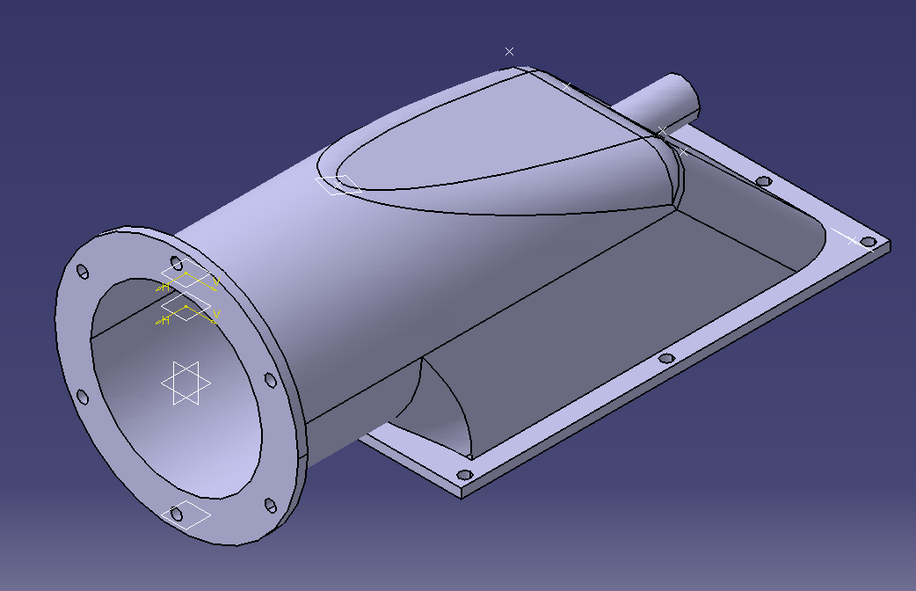
PACKAGING DESIGN
Detailed CAD Model Illustration

Slide 10
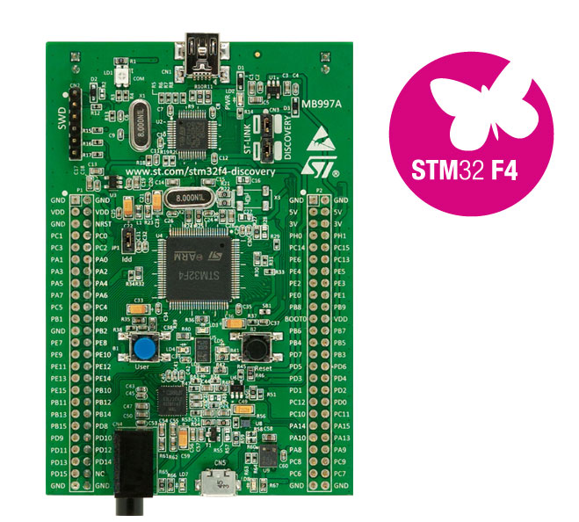
MAJOR COMPONENTS
Microcontroller - STM32F407VGT6
UART, SPI, I2C, PWM(TIM), DMA, ADC peripherals
16 ADC channels
Familiar coding tool and libraries

Slide 11
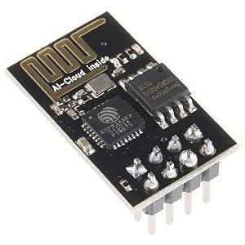
MAJOR COMPONENTS
Wi-Fi Module - ESP8266
Robust Wi-Fi module
Dual communication
Server or client
HTTP, TCP, UDP
UART protocol
115200 Baud Rate

Slide 12
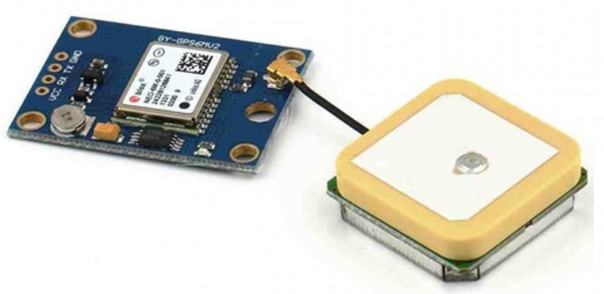
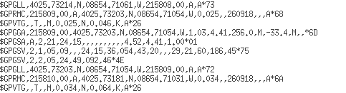
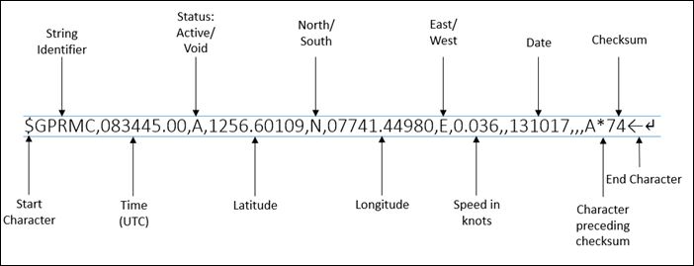
MAJOR COMPONENTS
GPS Module - Ublox NEO-6M
UART protocol
9600 Baud Rate
National Marine Electronics Association (NMEA) Format
$GPRMC (recommended minimum data for gps)
Latitude & Longitude
Speed in Knots

Slide 13
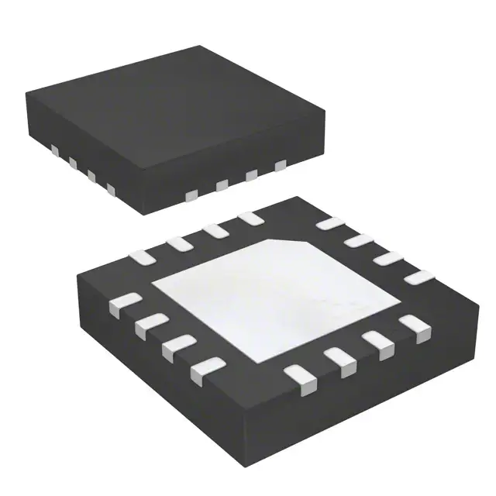
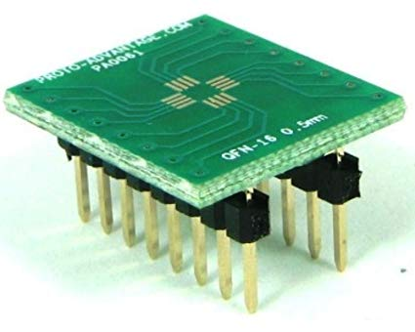
MAJOR COMPONENTS
Compass Module - Melexis MLX90393
SPI protocol
I2C protocol

Slide 14
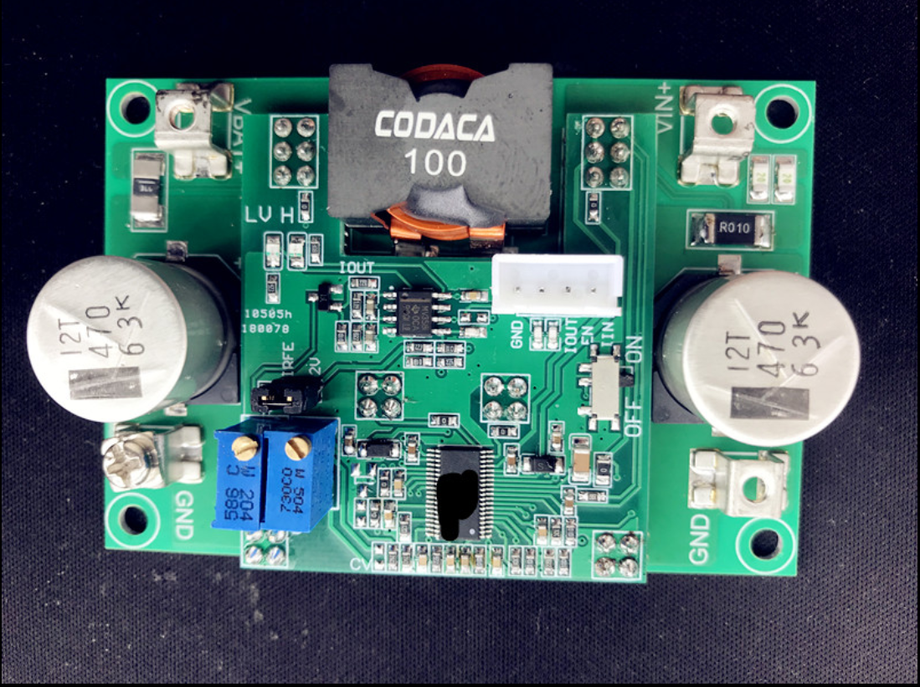
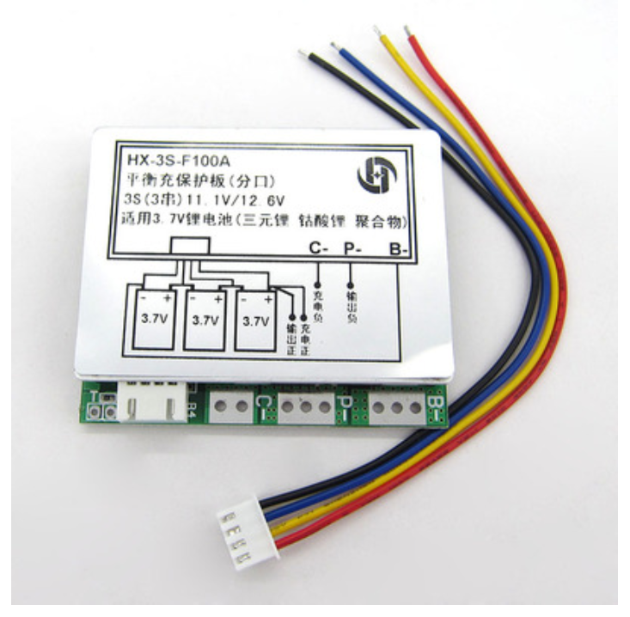
MAJOR COMPONENTS
Batteries and Battery Charging
Two 8000mAh Li-Po batteries
One 3000mAh Li-Po battery
Charging protection board for charging
Charging circuit board supports three cells battery charging
Charging Circuit
Protection Board

Slide 15
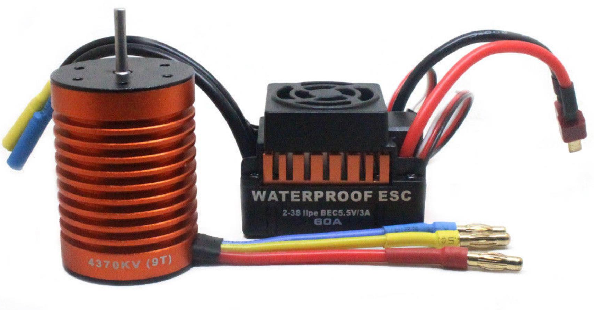
MAJOR COMPONENTS
Turbojet - Brushless DC Motors
High torque
High speed
High efficiency
Speed control through Electrical Speed Control
PWM signal inputs

Slide 16
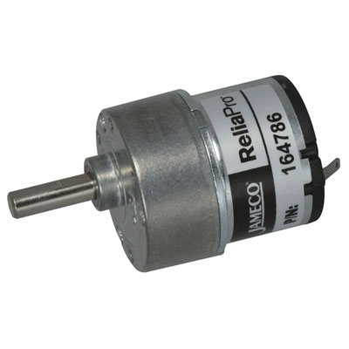
MAJOR COMPONENTS
Conveyor Belt - Brushed DC Motors
High Torque
Low Speed
Operated from 4.5V to 20V

Slide 17
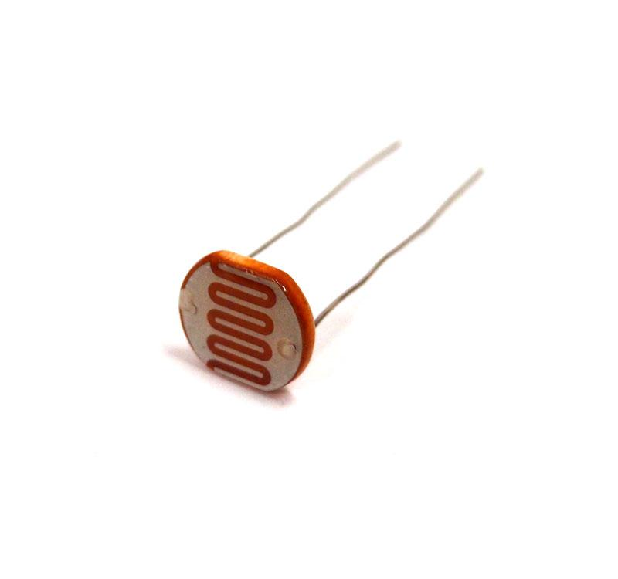
MAJOR COMPONENTS
Break Beam Sensor - Light-Dependent Resistor (LDR)
Easy to design circuit
Cheap to purchase
Change resistance based on light intensity

Slide 18
ELECTRICAL SCHEMATIC
Schematics Overview

Slide 19
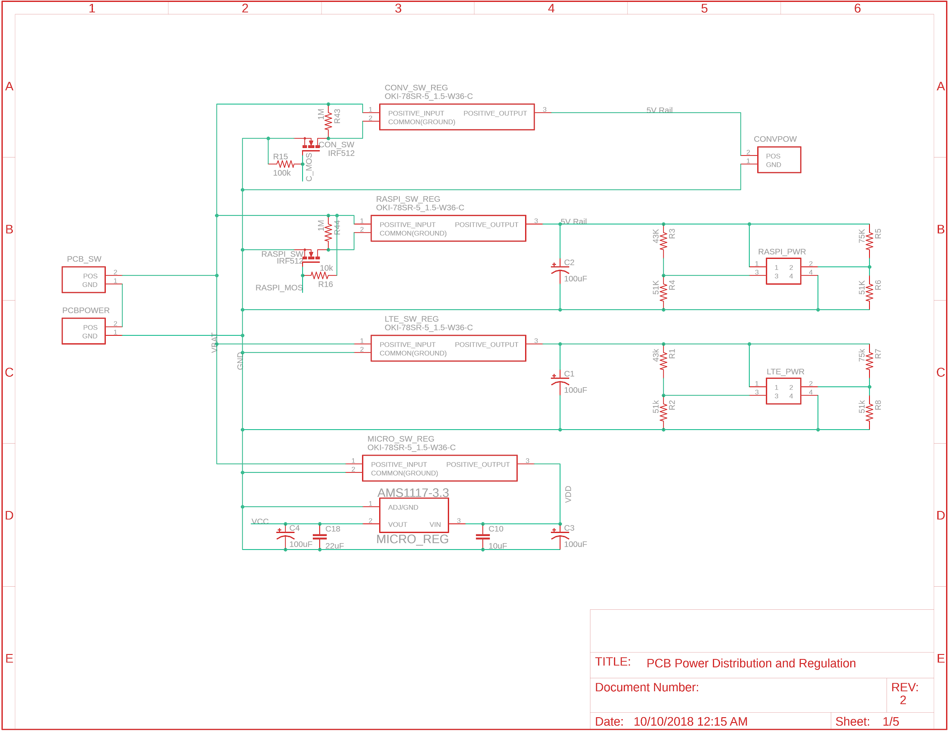
ELECTRICAL SCHEMATIC
PCB Power Distribution and Regulation
XT60 Connectors
OKI-78SR
USB
AMS1117
2V on D-
2.7V on D+
Allows 2.1A max output per USB-IF standard

Slide 20
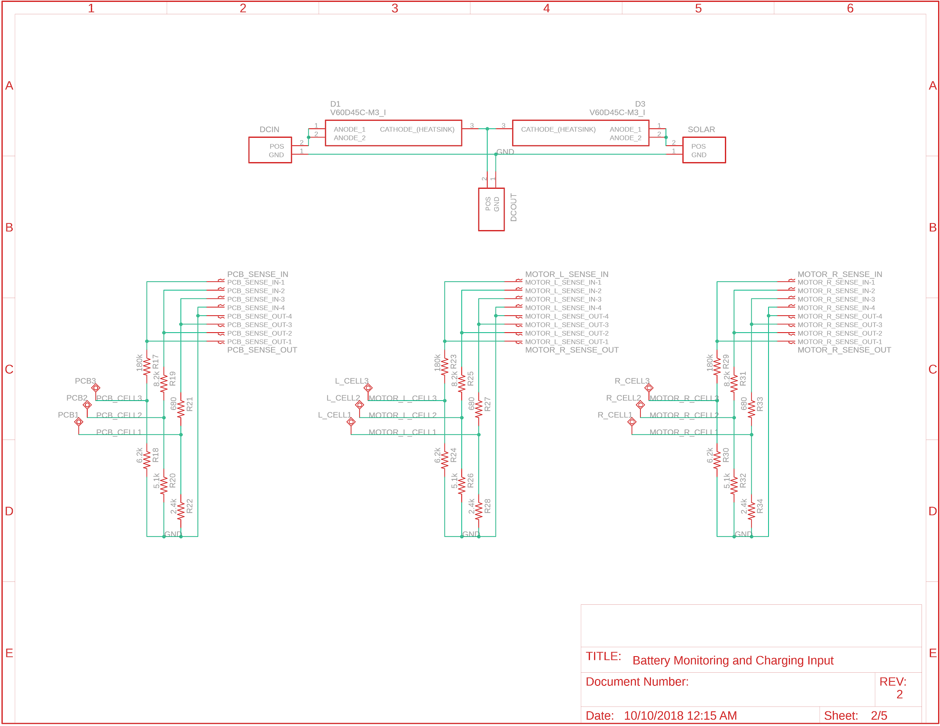
ELECTRICAL SCHEMATIC
Battery Monitor and Charging Protection
V60D45C Diode
45V
2*30A
3.287V@4.2V
0.006W
3.261V@8.4V
0.005W
3.276V@12.6V
0.007W

Slide 21
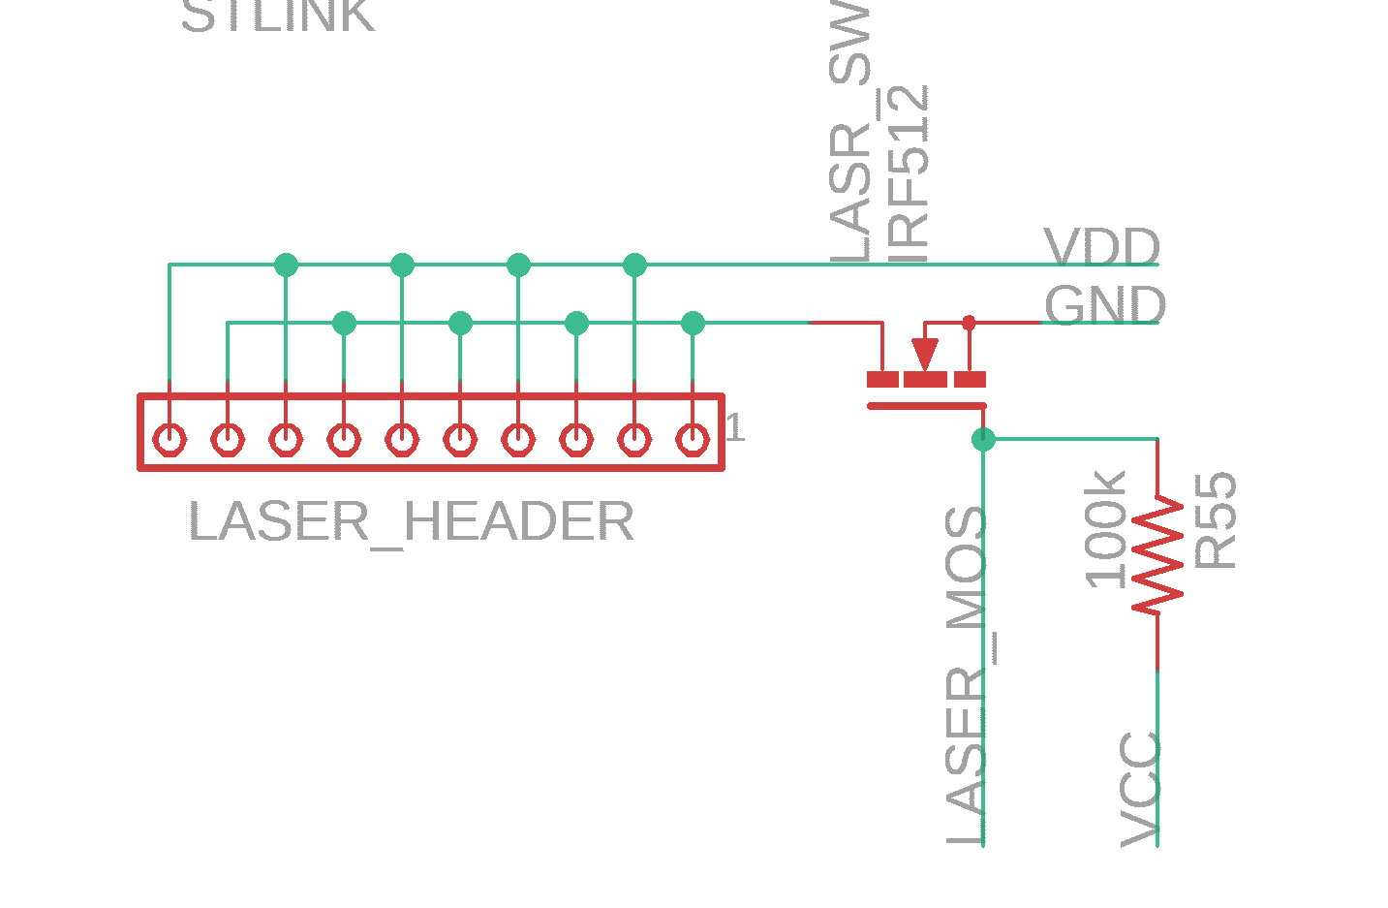
ELECTRICAL SCHEMATIC
Laser Header
Laser Header
MOSFET Switch

Slide 22
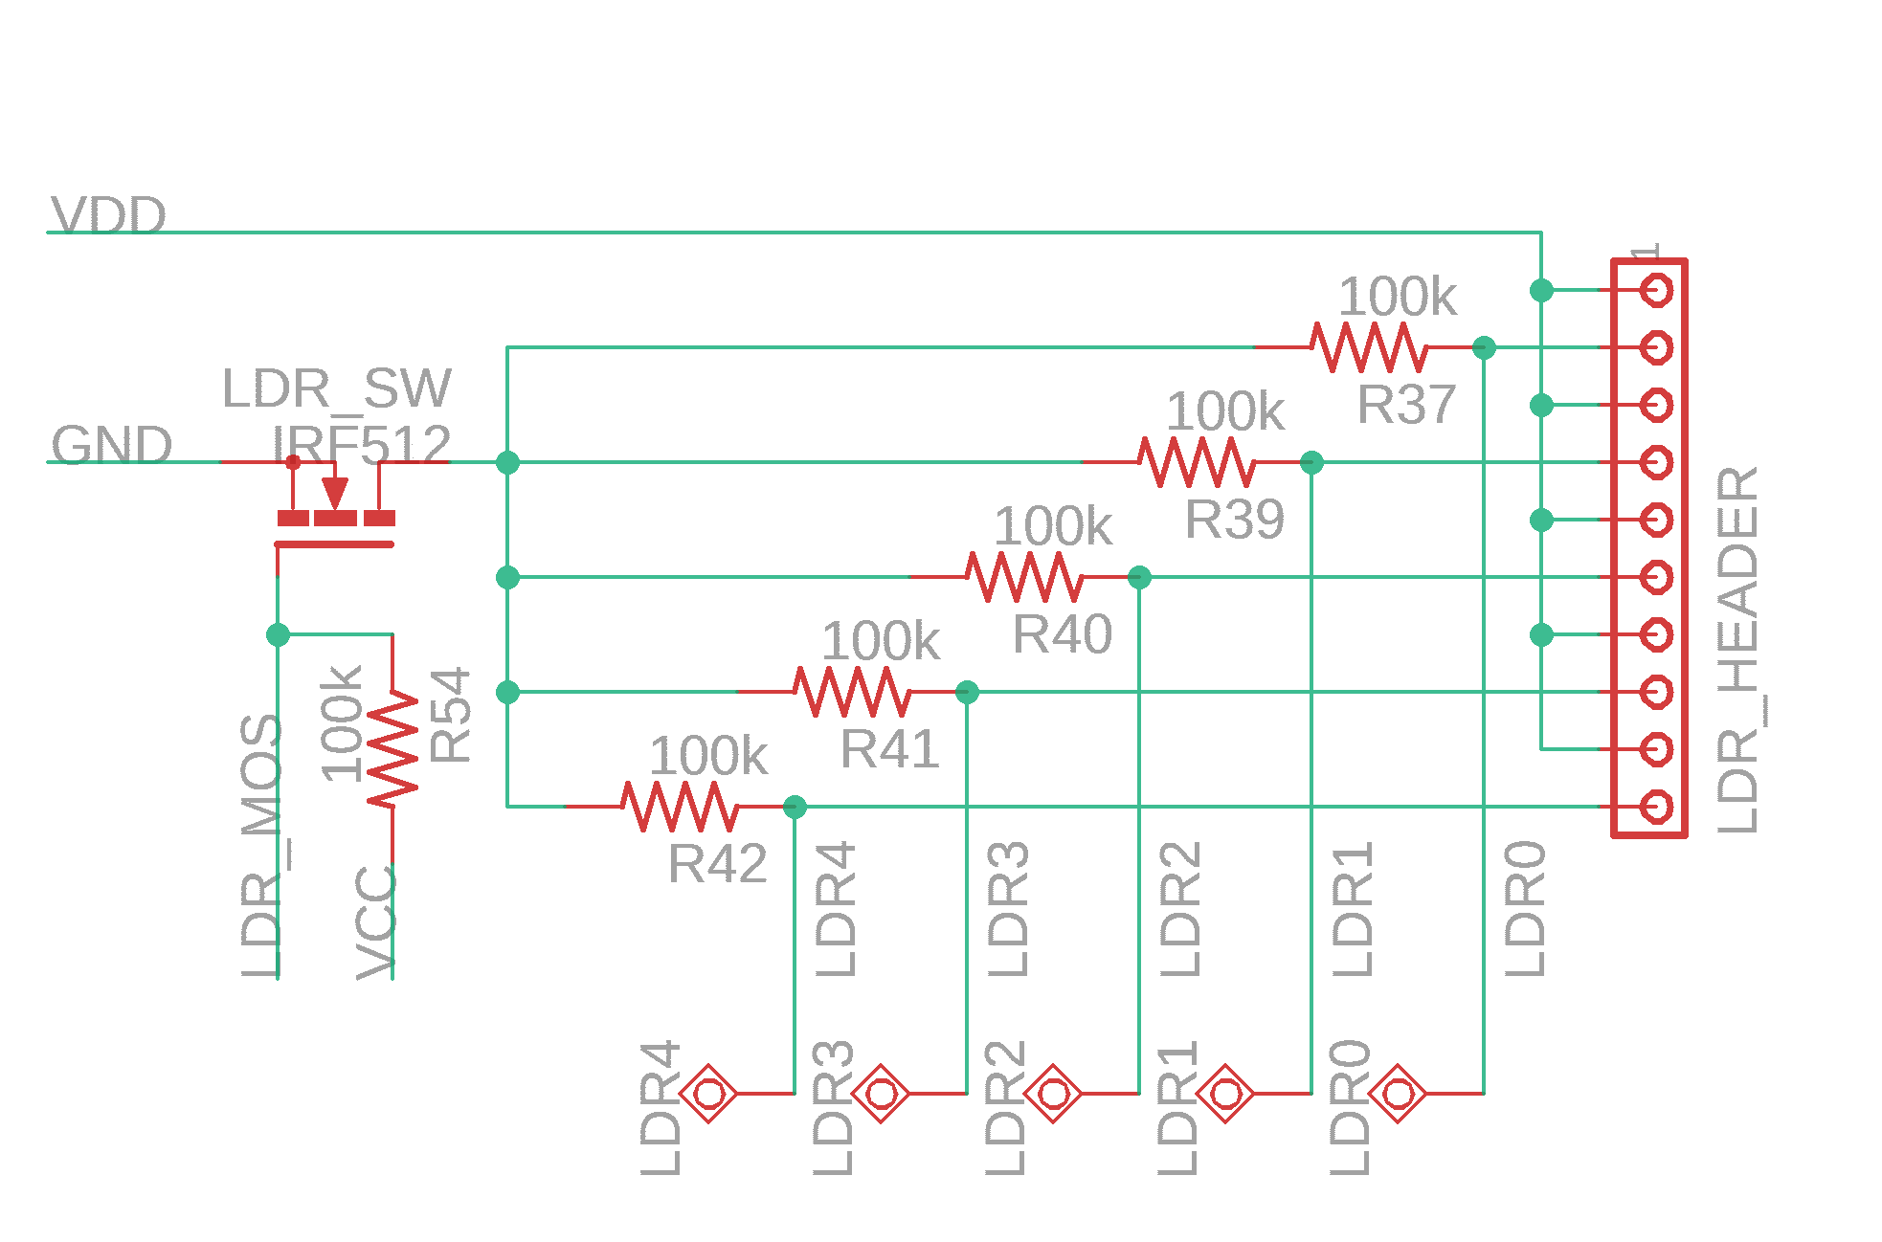
ELECTRICAL SCHEMATIC
LDR Circuit
Test points for each LDR
MOSFET as switch

Slide 23
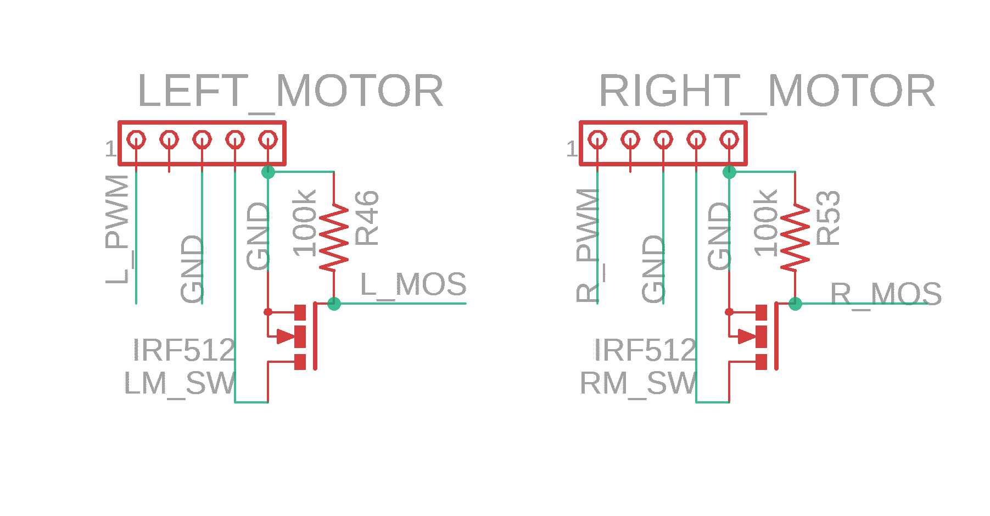
ELECTRICAL SCHEMATIC
Motor Drivers
MOSFET acts as ESC’s power switch

Slide 24
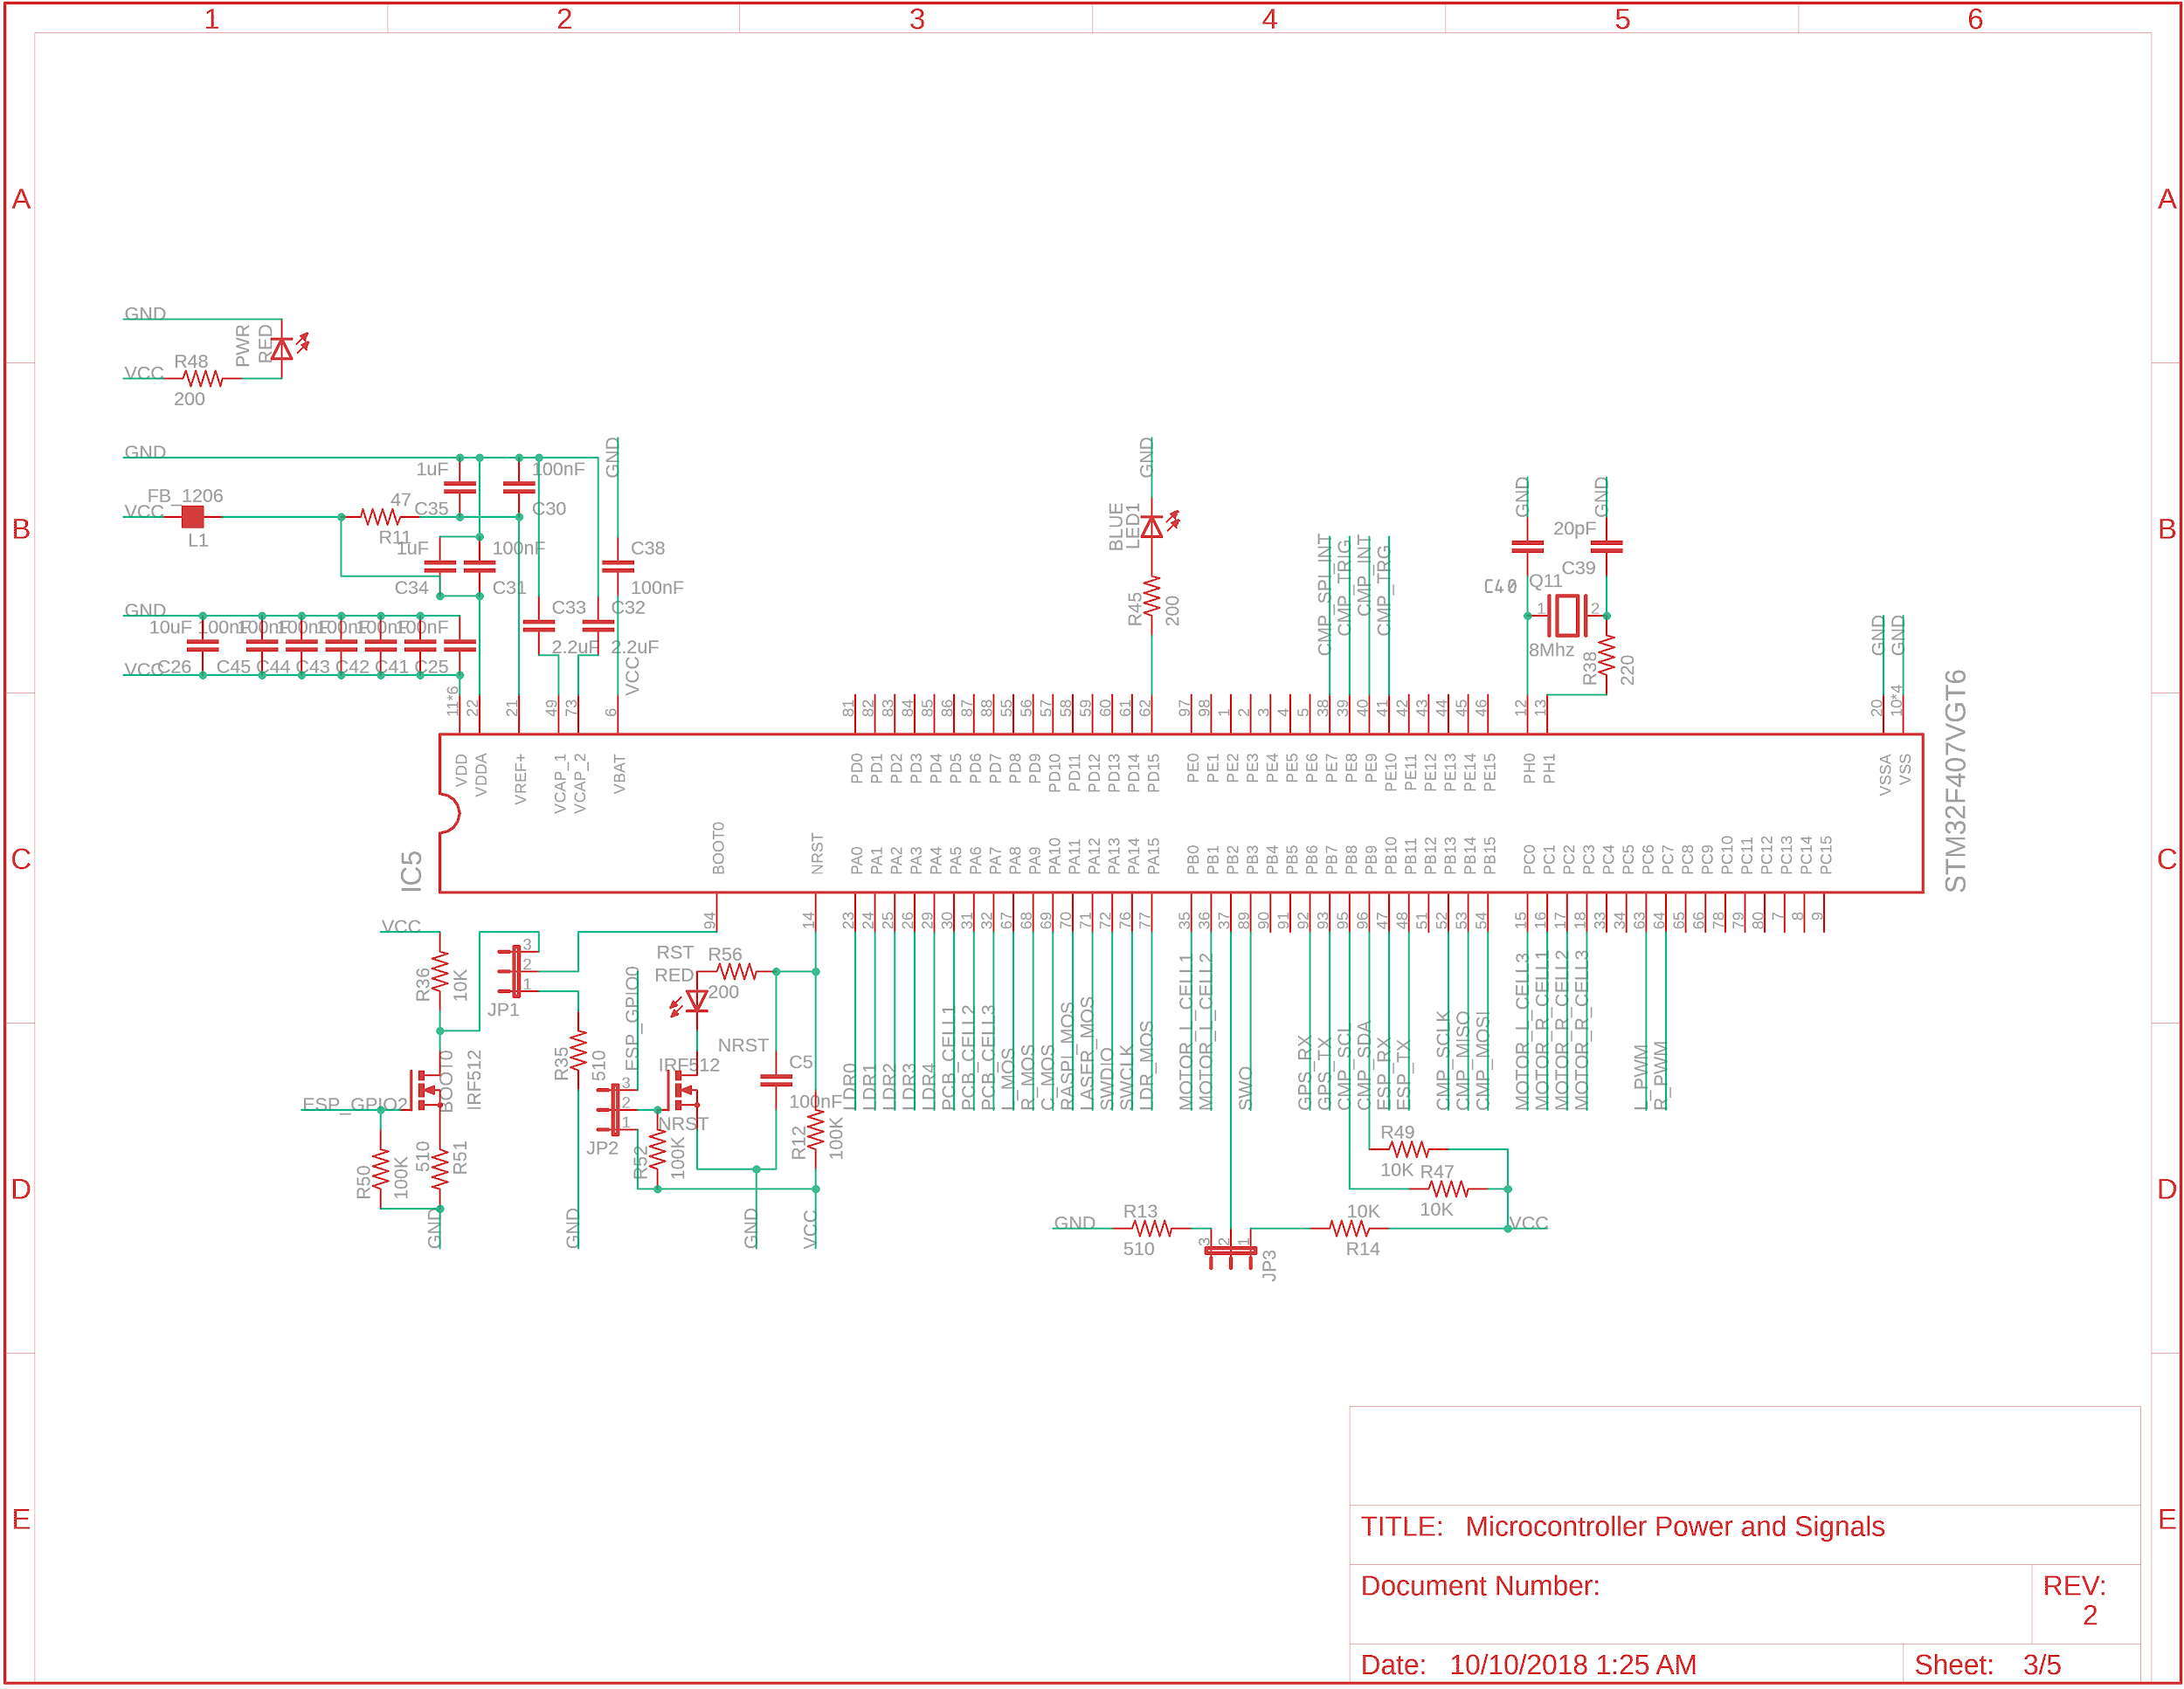
ELECTRICAL SCHEMATIC
Microcontroller
Power LED
8 Mhz Crystal
Decoupling Caps
Blinking LED

Slide 25
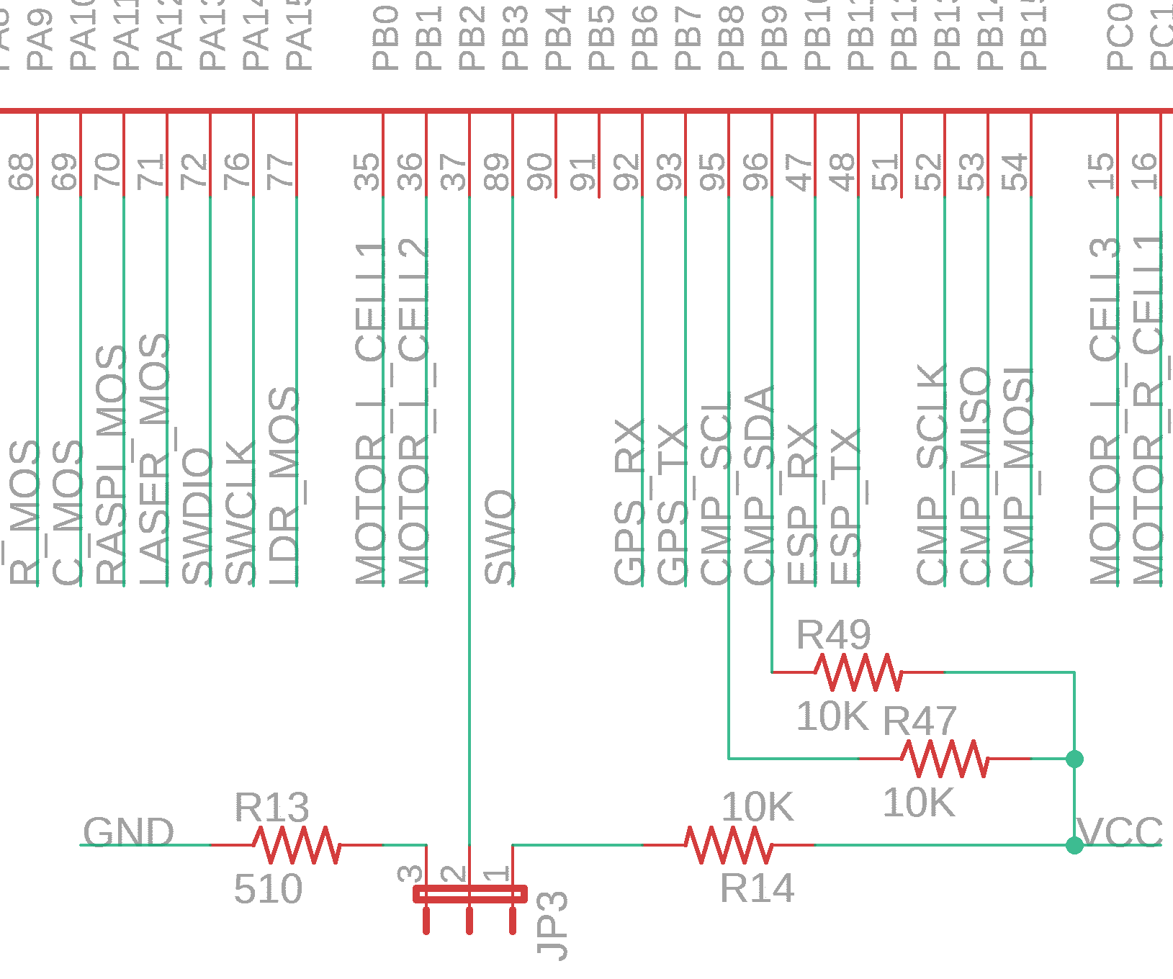
ELECTRICAL SCHEMATIC
BOOT1
Jumper controls pull up or pull down resistor on BOOT1.
Pullup used with STLINK programming
Pulldown used with UART programming

Slide 26
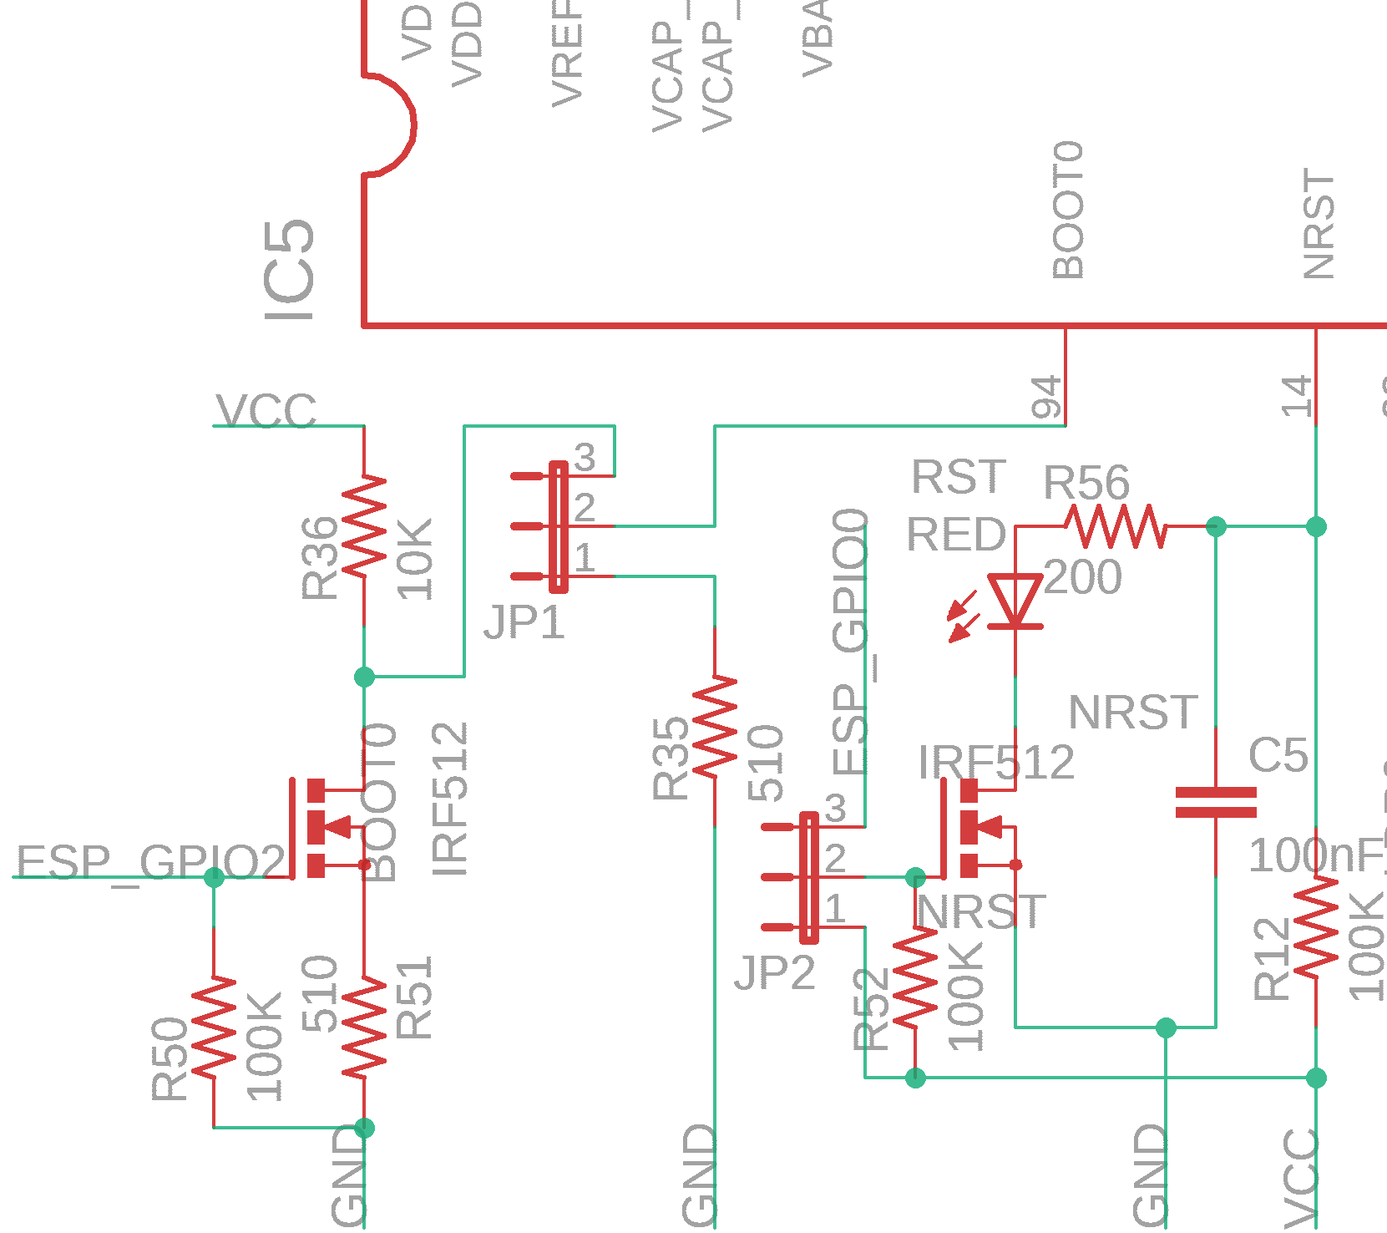
ELECTRICAL SCHEMATIC
BOOT0 and NRST
JP2 controls manual reset or reset using ESP8266
NRST is connected to STLINK header
JP1 pulldown by default
pulling up JP1 enables UART programming controlled by ESP8266

Slide 27
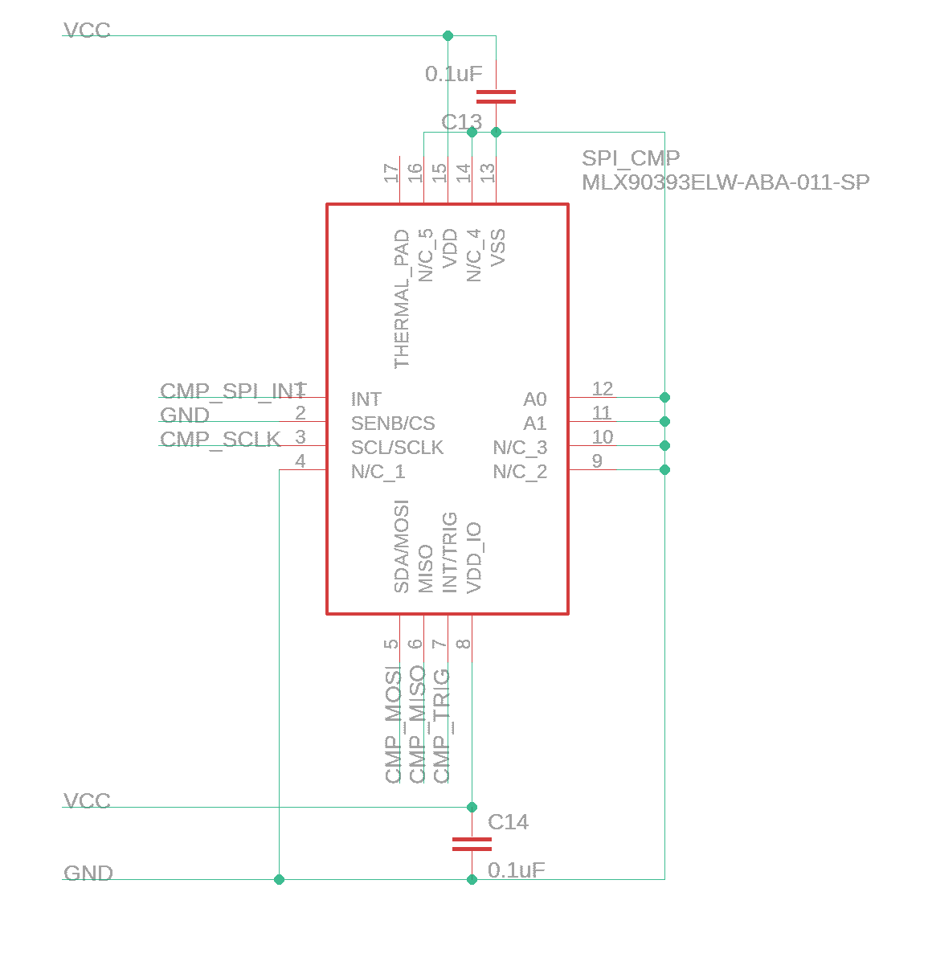
ELECTRICAL SCHEMATIC
Compass
MLX90393 Magnetic Node
SPI
Onboard

Slide 28
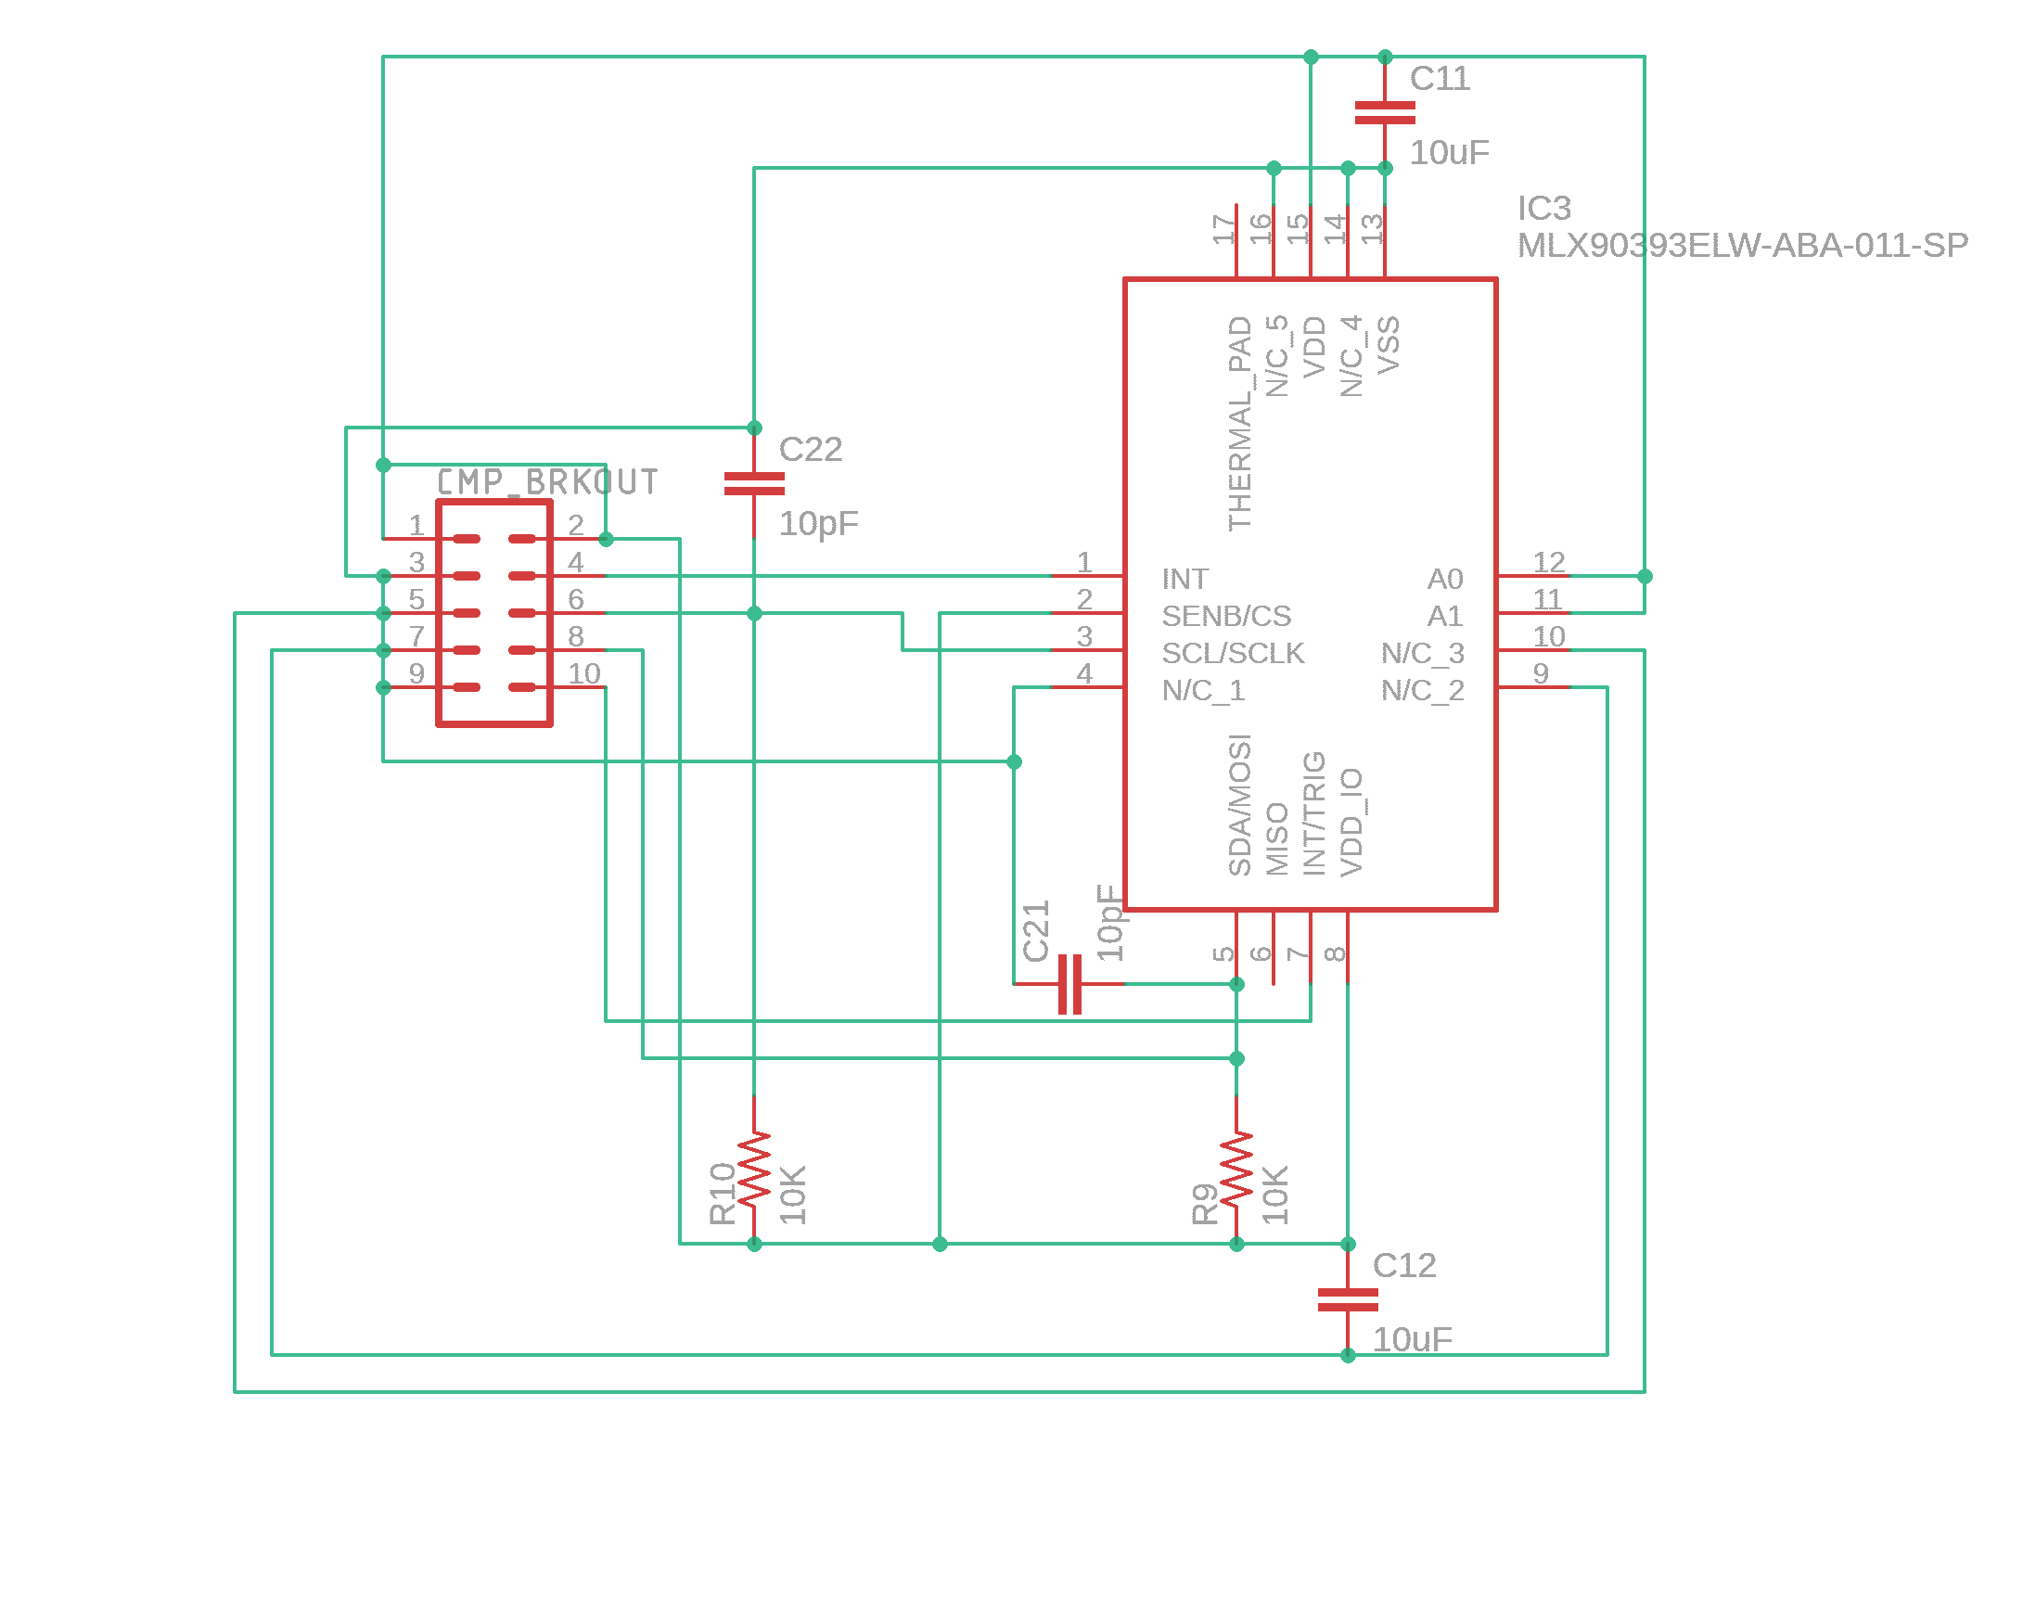
ELECTRICAL SCHEMATIC
Compass Breakout
Compass Breakout
I2C interface
Used when magnetic interference is too big on the PCB

Slide 29
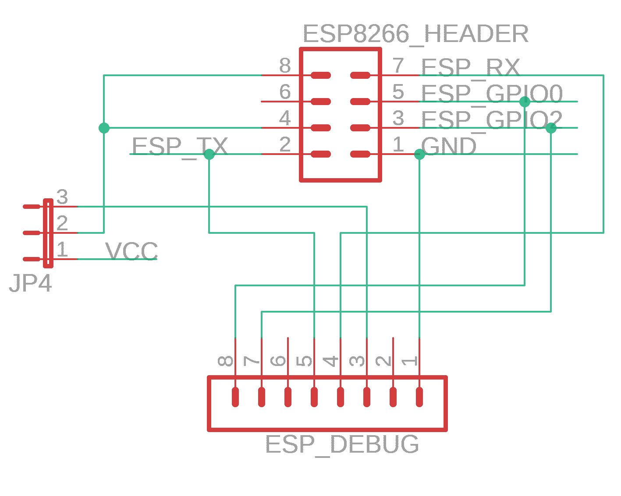
ELECTRICAL SCHEMATIC
ESP8266 Wifi Module and Debug
ESP8266 Header
JP4 enables UART debugging for ESP8266
ESP8266 GPIO’s utilized for microcontroller programming over UART

Slide 30
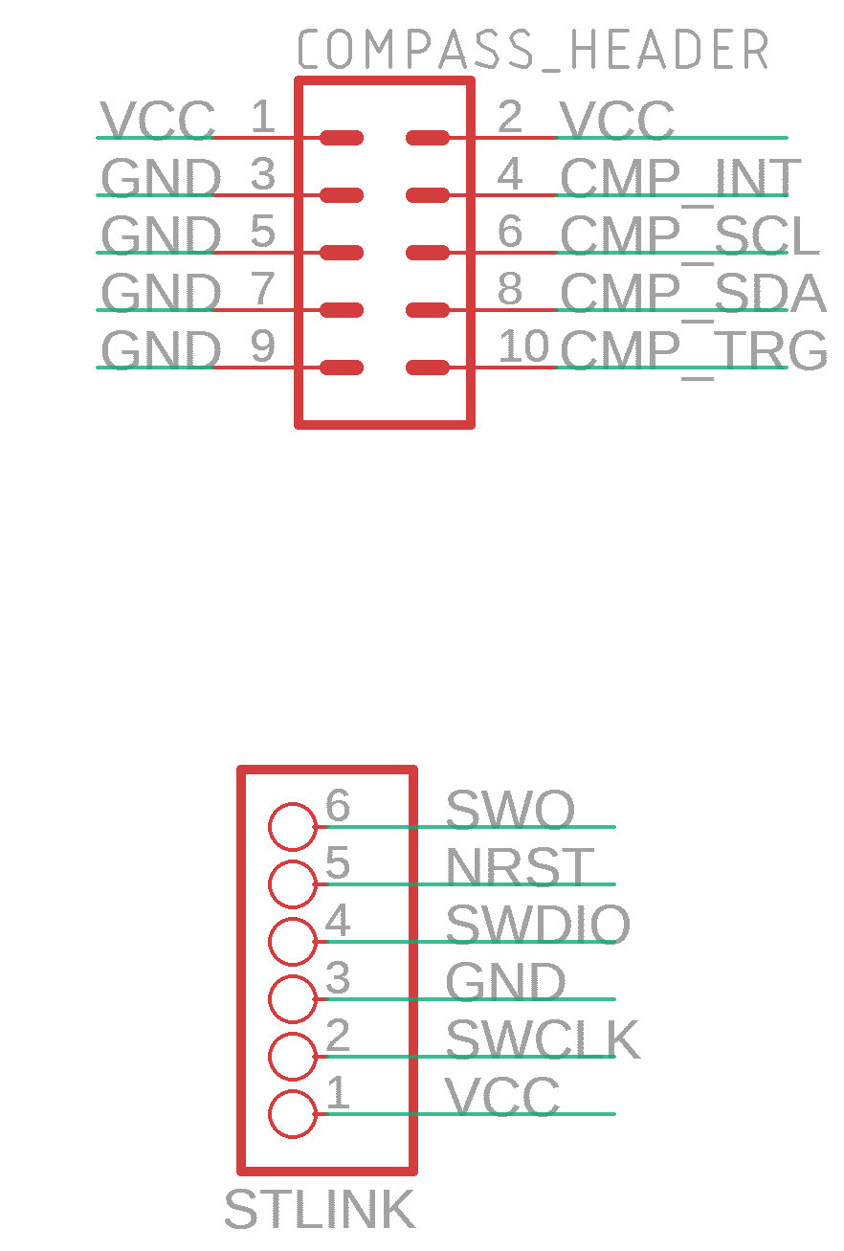
ELECTRICAL SCHEMATIC
Compass Header and STLINK
Compass header for compass breakout board using I2C protocol.
STLINK headers for STLINK programming

Slide 31
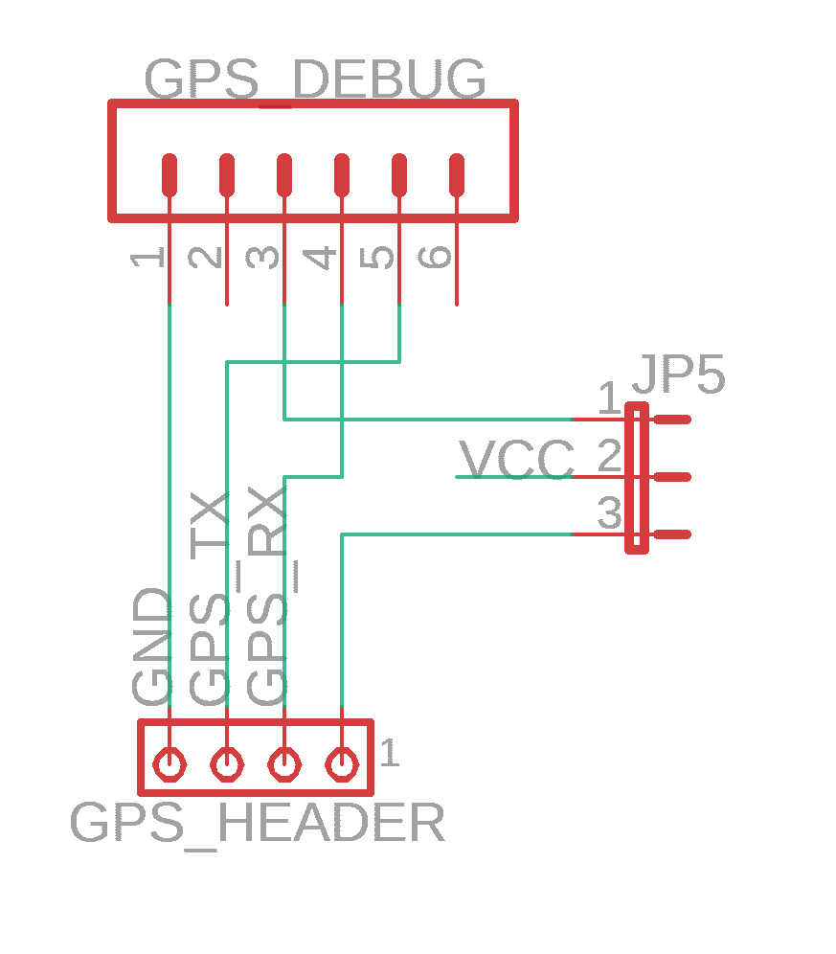
ELECTRICAL SCHEMATIC
GPS Module and GPS Debug
GPS Header
Jumper enables UART debugging of GPS module

Slide 32
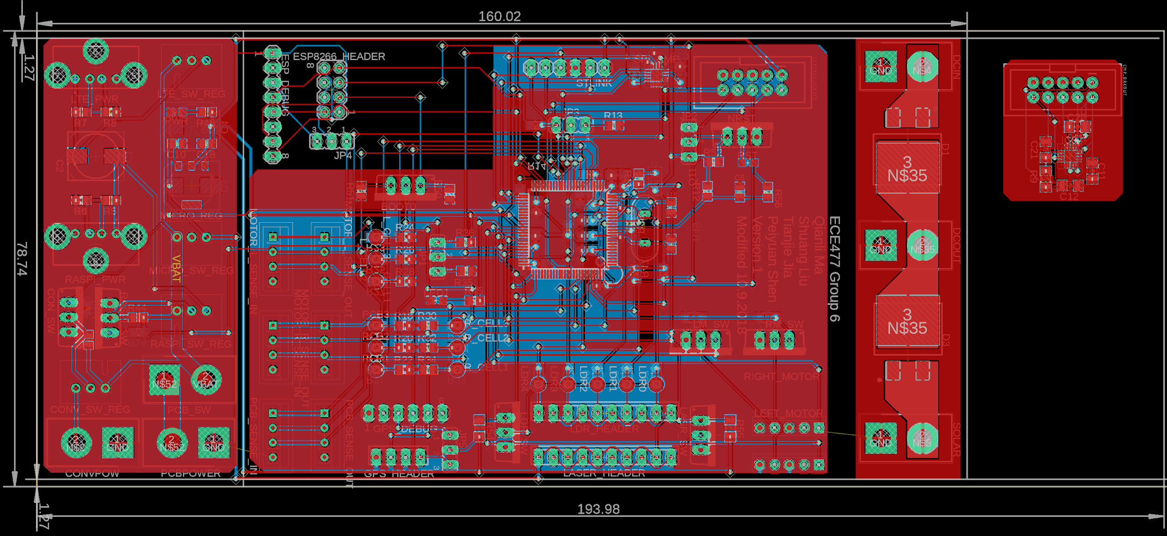
PCB LAYOUT
Overview

Slide 33
PCB LAYOUT
Overview
160.02mm*78.74mm PCB dimension excluding compass breakout board
193.98mm*78.74mm including compass breakout board
Slot mounted
Package 80mm wide
Board has at least 1.27mm space without components on both sides used for mounting
Heavily utilizes connectors for a modular design
XT60 used for power connectors
MTA used for almost every peripheral
USB for LTE modem and Raspberry Pi
Separate ground planes connected by battery grounds to minimize noise between circuits
Board divided into power regulator section, main section, high current section, and breakout board

Slide 34
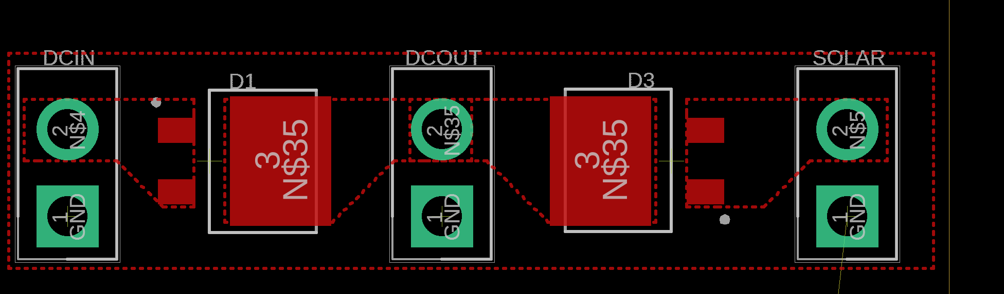
PCB LAYOUT
Power
Utilizes XT60 connector for power
Diodes prevents shorts and current backflow
Solar panel output is smaller than DCIN

Slide 35
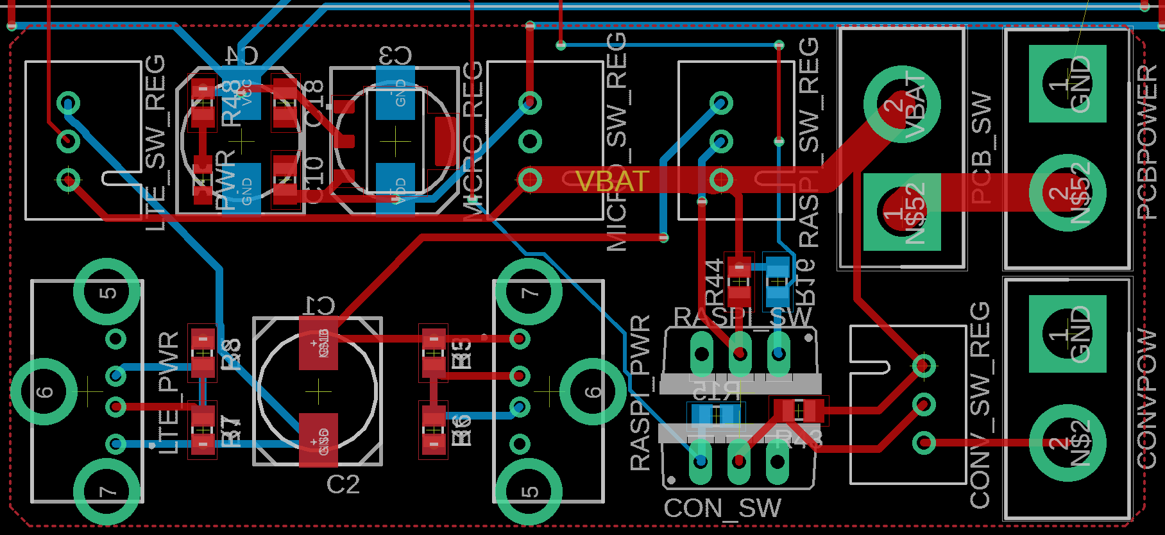
PCB LAYOUT
Power Distribution
Bottom of PCB
Prevents switching noise in rest of the circuit
USB female connectors for Raspberry Pi and LTE modem

Slide 36
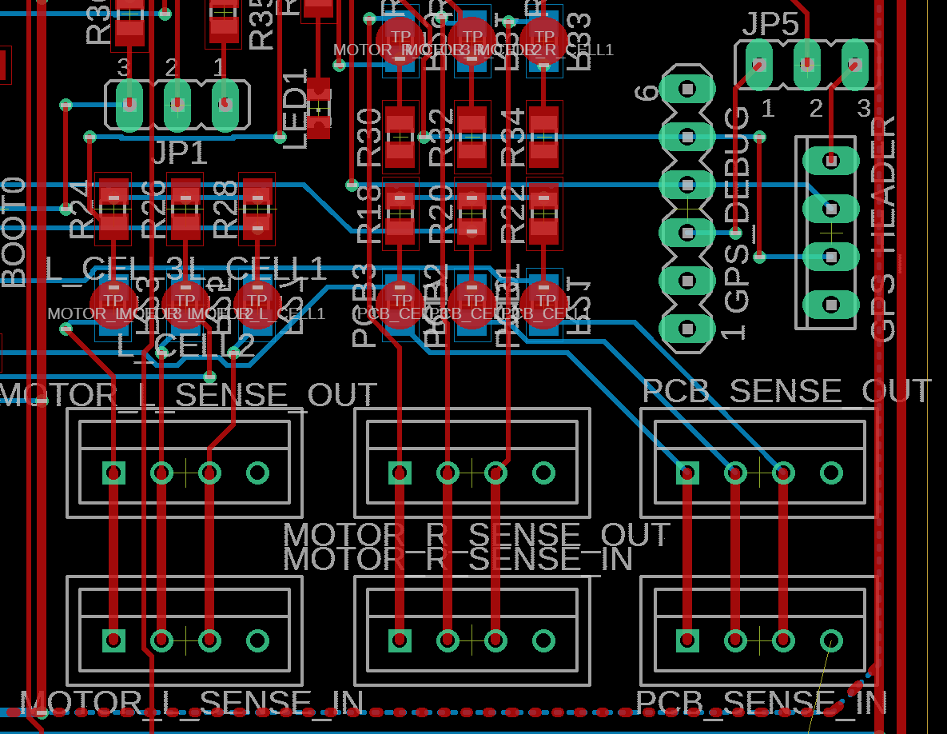
PCB LAYOUT
GPS Connectors and Battery Monitor
GPS header uses MTA connector
LiPo balancing wires uses JST-XH connectors

Slide 37
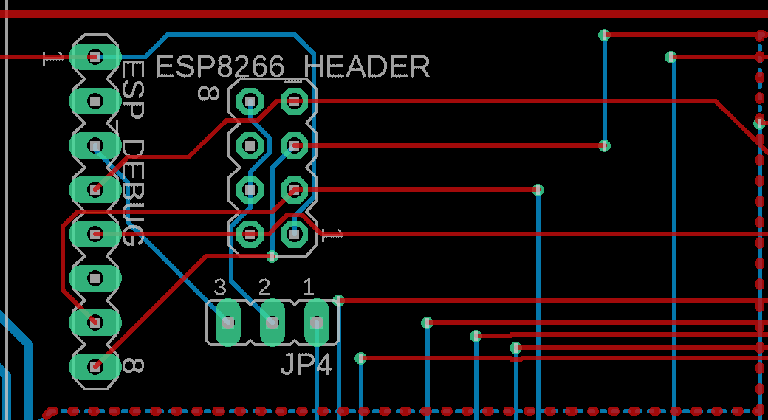
PCB LAYOUT
WIFI Header and Debug
ESP8266 Header with no ground plane
Debugging header and jumper beside it

Slide 38
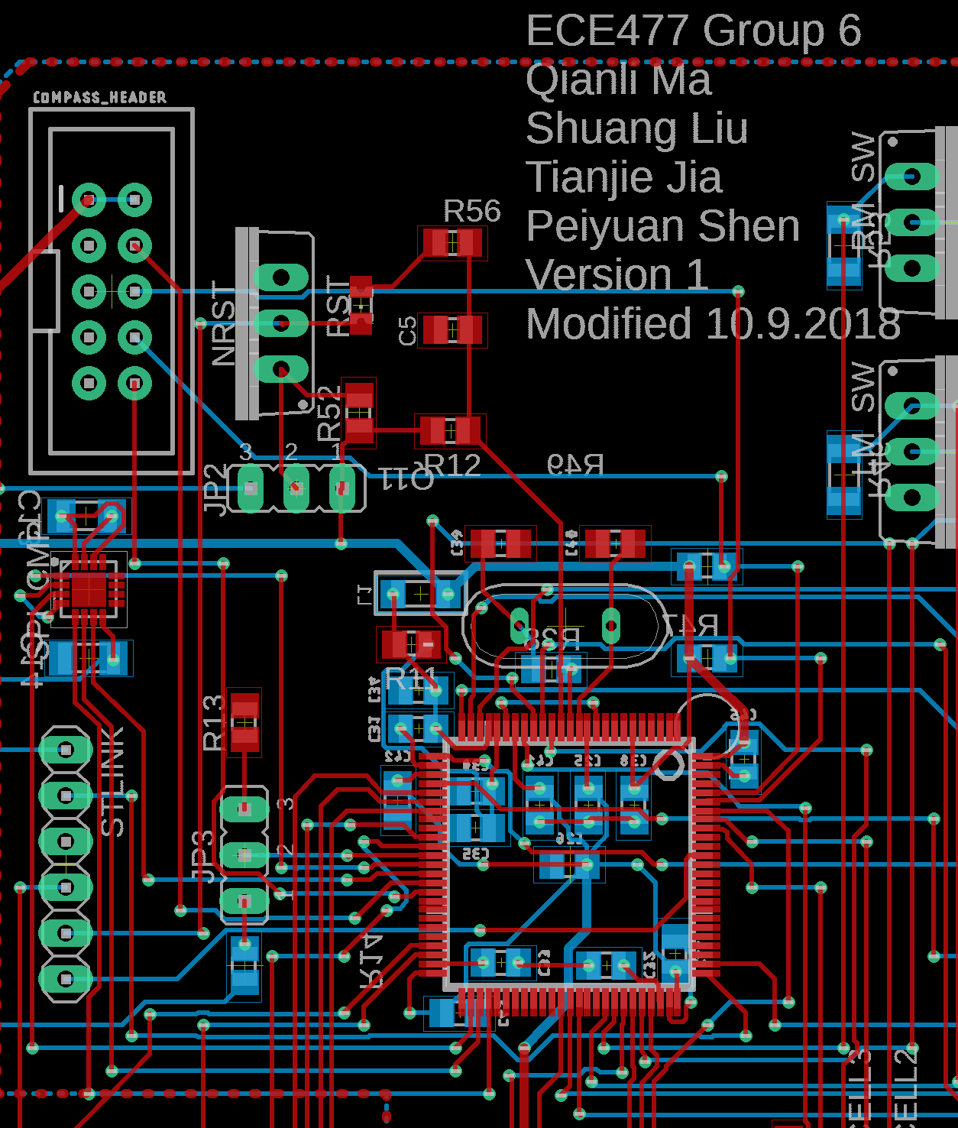
PCB LAYOUT
Micro, STLINK, Compass
Micro has bulk of decoupling caps under the micro
STLINK on the left of the micro
Compass header uses an 10 pin SWD connector
Additional I2C pullup resistors on main PCB
SPI compass away from other active components
Oscillator close two micro, both path almost the same length

Slide 39
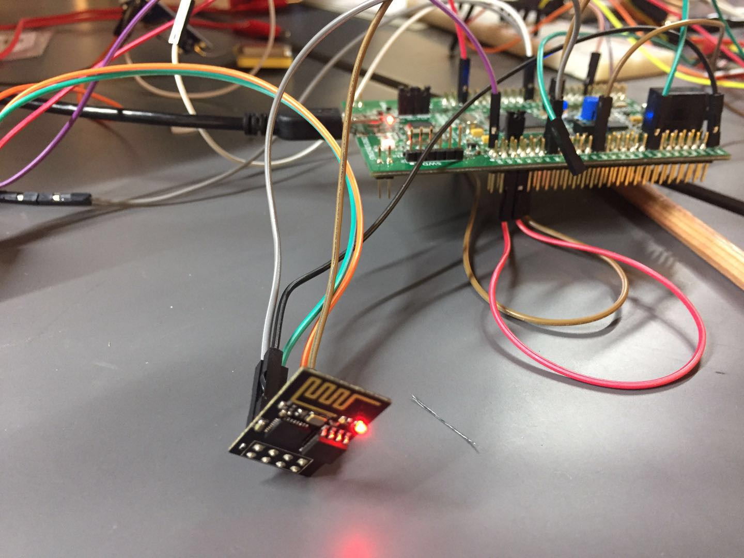
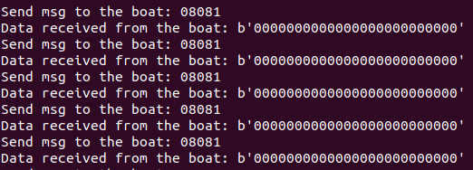
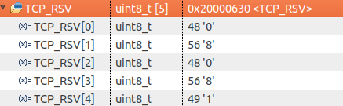
PROTOTYPING PROGRESS
Wi-Fi Module
Setup TCP connection through UART protocol
Receive fix-length commands
Send fix-length message
Todo: Finalize message data structure

Slide 40
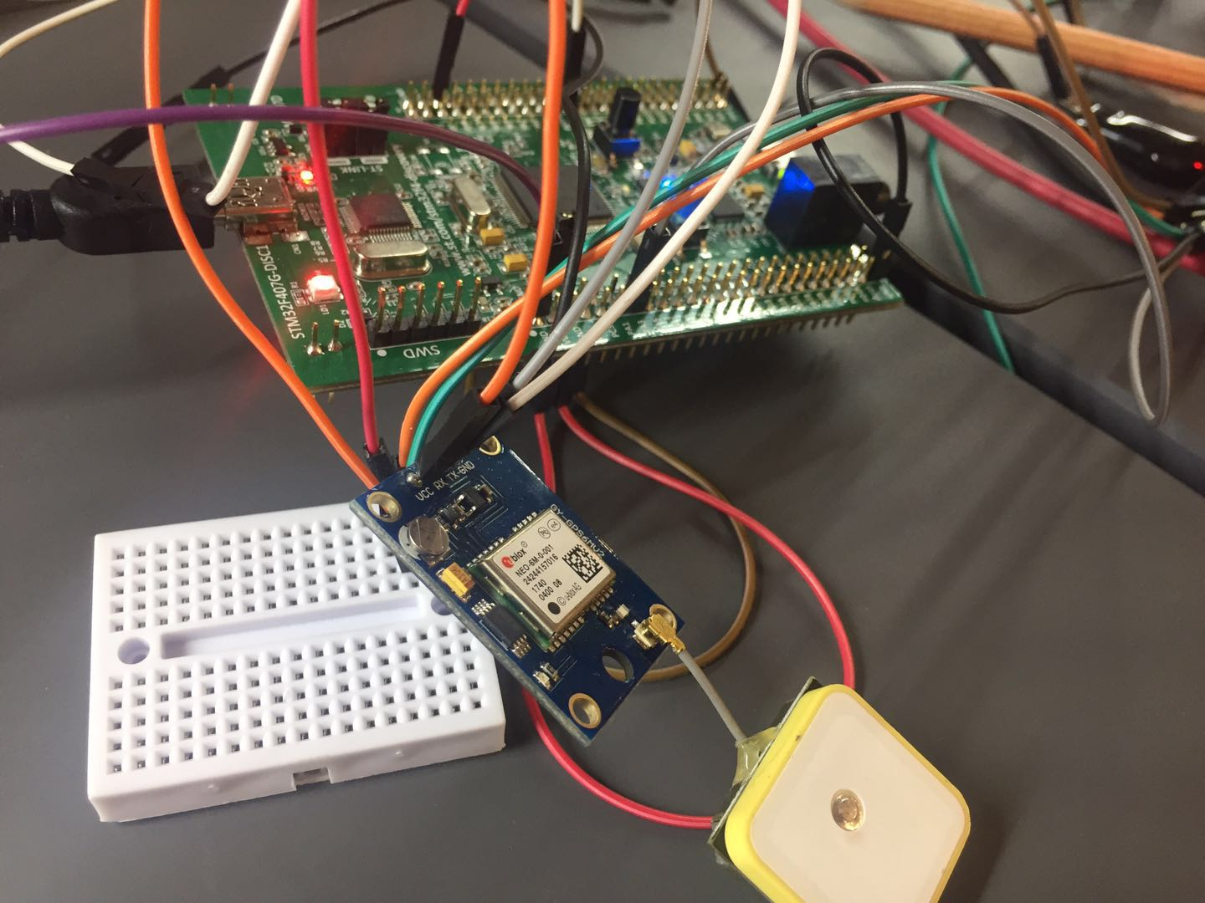
PROTOTYPING PROGRESS
GPS Info Extraction
Receive information in NMEA format
Extract $GPGGA (Fix information) sentences
Send Lat & Lng
Todo: Extract $GPRMC (recommended minimum data for gps) and send speed info

Slide 41
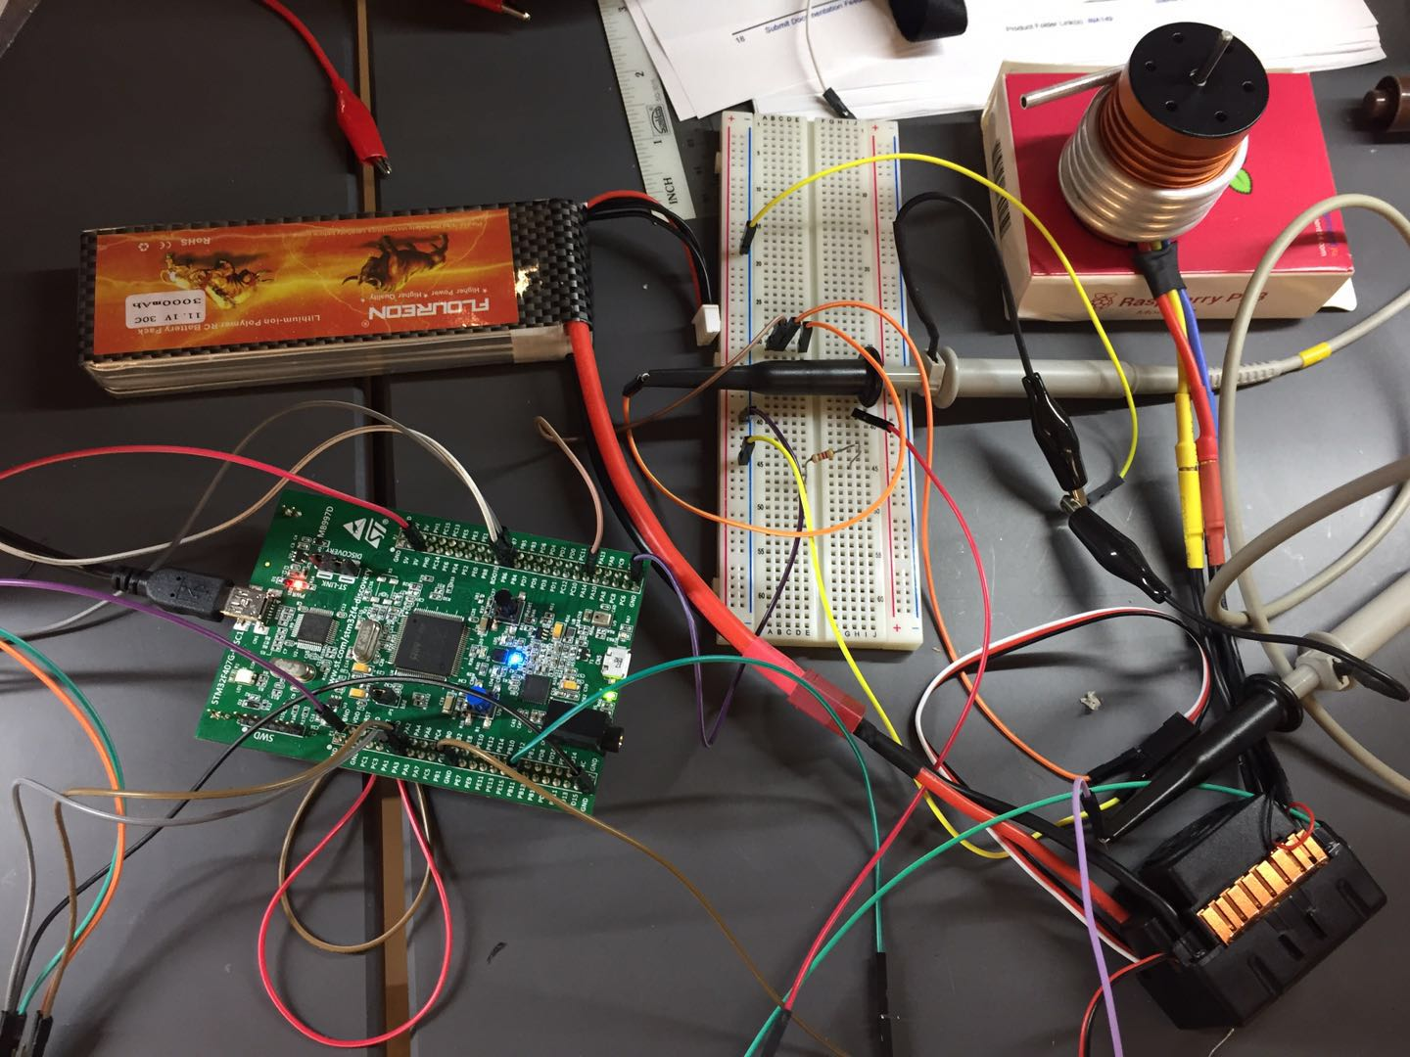
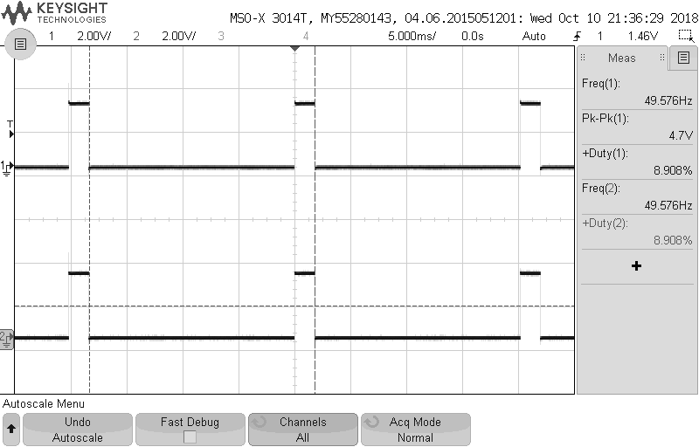
PROTOTYPING PROGRESS
Turbojet PWM Speed Control
ESC setup
Motor speed controlled by the duty cycle of PWM signal
Range: 7% - 12%
Todo: Control by commands received through Wi-Fi

Slide 42



PROTOTYPING PROGRESS
LDR Sensor System
Measure voltage across LDR through an ADC channel
Todo: Complete all 14 channels

Slide 43
PROTOTYPING PROGRESS
Boat Package
Two chambers with a storage unit in the middle
Turbojet model printed
Todo: Assemble the boat and the turbojets

Slide 44
PROTOTYPING PROGRESS
Conveyor Belt
Prototype built and tested
Issue: The connector has to fit the D-shaft of the motor
Todo: 3D-print the motor connectors
Notes:
the connector has to fit the D-shaft of the motor to ensure the gripping between the motor and bearing bar

Slide 45

PROTOTYPING PROGRESS
Compass Module
Compass Module arrived
Ordered the breakout board
Todo: Test the module after soldered on the breakout board

Slide 46
SOFTWARE DEVELOPMENT STATUS
User Interface
Part 1:
Communicate with the boat
Send and receive message
Perform calculations
Part 2:
Main Window Application
Part 3:
Video Streaming

Slide 47
SOFTWARE DEVELOPMENT STATUS
Graphical User Interface

Slide 48

SOFTWARE DEVELOPMENT STATUS
Graphical User Interface

Slide 49

SOFTWARE DEVELOPMENT STATUS
Video Stream
Raspberry Pi obtains raw YUV color space data from camera
YUV data is compressed and send over TCP socket to user
720x480 pixel
~20 FPS
Todo: Convert YUV colorspace to RGB colorspace
Notes:
YUV only takes half the bandwidth of RGB
8Mb bandwidth usage

Slide 50
PROJECT TIMELINE
Week 8: Finalize PCB layout and schematic
Week 9: Continue building prototype boat, interface compass with microcontroller
Week 10: Program fix-route algorithm in GUI user-interface, construct power system circuit
Week 11: Solder PCB components, test prototype boat in different environment
Week 12: Integrate all software components and hardware components
Week 13: Formal packaging, continue integration and testing
Week 14: Continue package integration and testing
Week 15: Final testing and documentation
Week 16: Design showcase

Slide 51
Questions?

Slide 52

APPENDIX
Software Progress

Slide 53

APPENDIX
Micro Software Progress

Slide 54

APPENDIX
Micro Software Progress

Slide 55

APPENDIX
Micro Software Progress

Slide 56


APPENDIX
GUI Software Progress

Slide 57

APPENDIX
GUI Software Progress

Slide 58

APPENDIX
Video Stream Software Progress

Slide 59

APPENDIX
Video Stream Software Progress

Slide 60

APPENDIX
Video Stream Software Progress

Slide 61

APPENDIX
Video Stream Software Progress

